Slide 1
Introduction to
Building Agentic AI Systems
Dipanjan (DJ) Sarkar

Slide 2
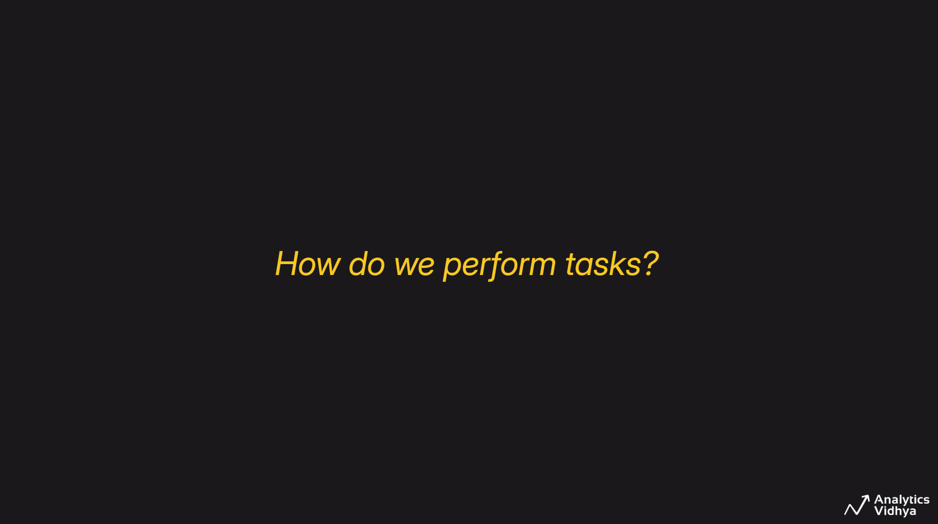

Slide 3
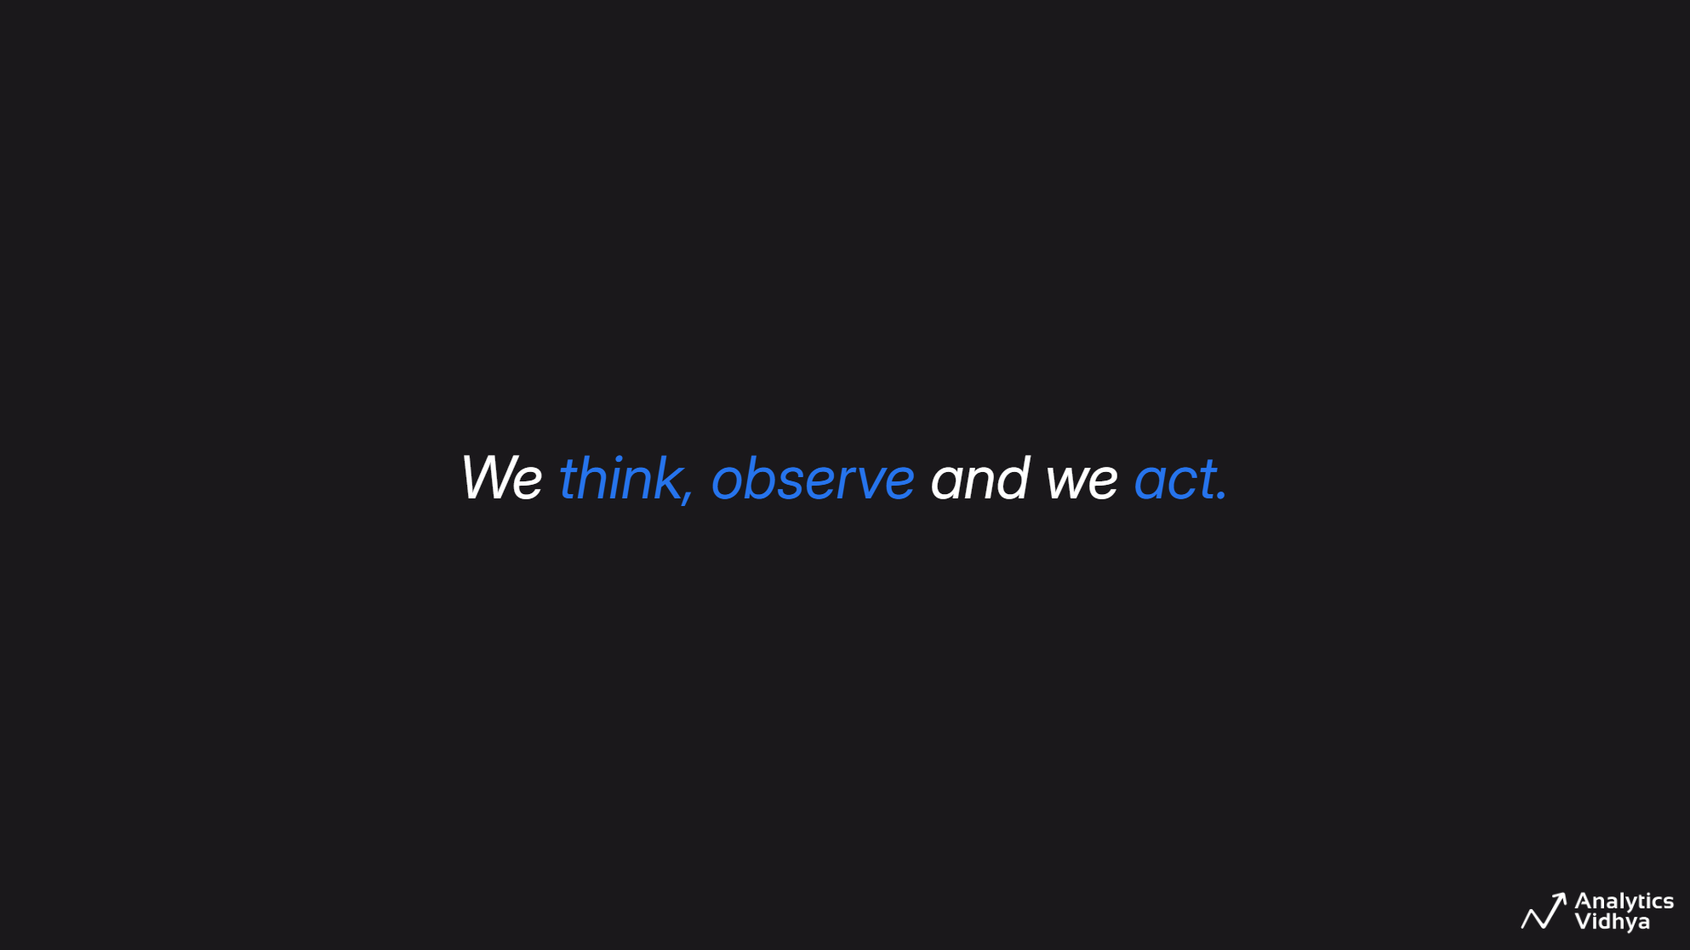

Slide 4
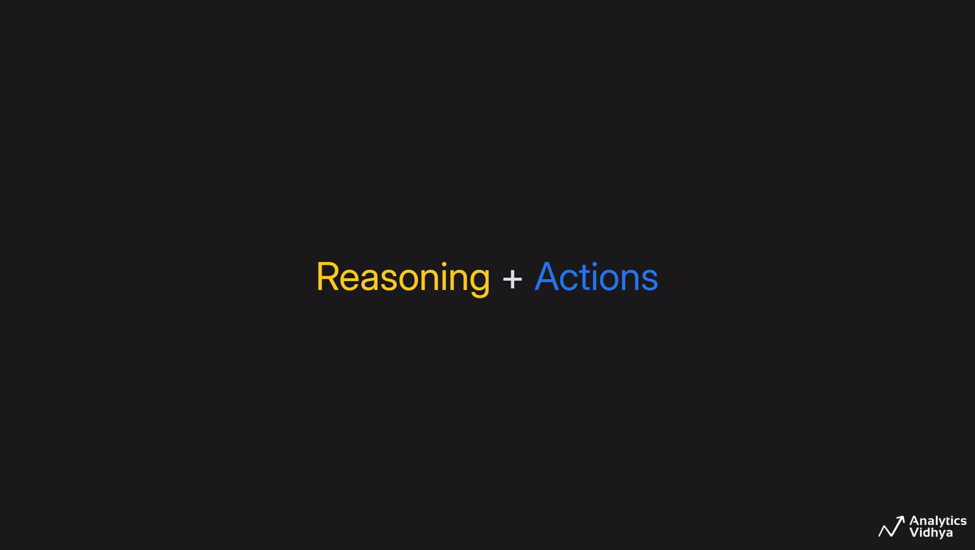

Slide 5
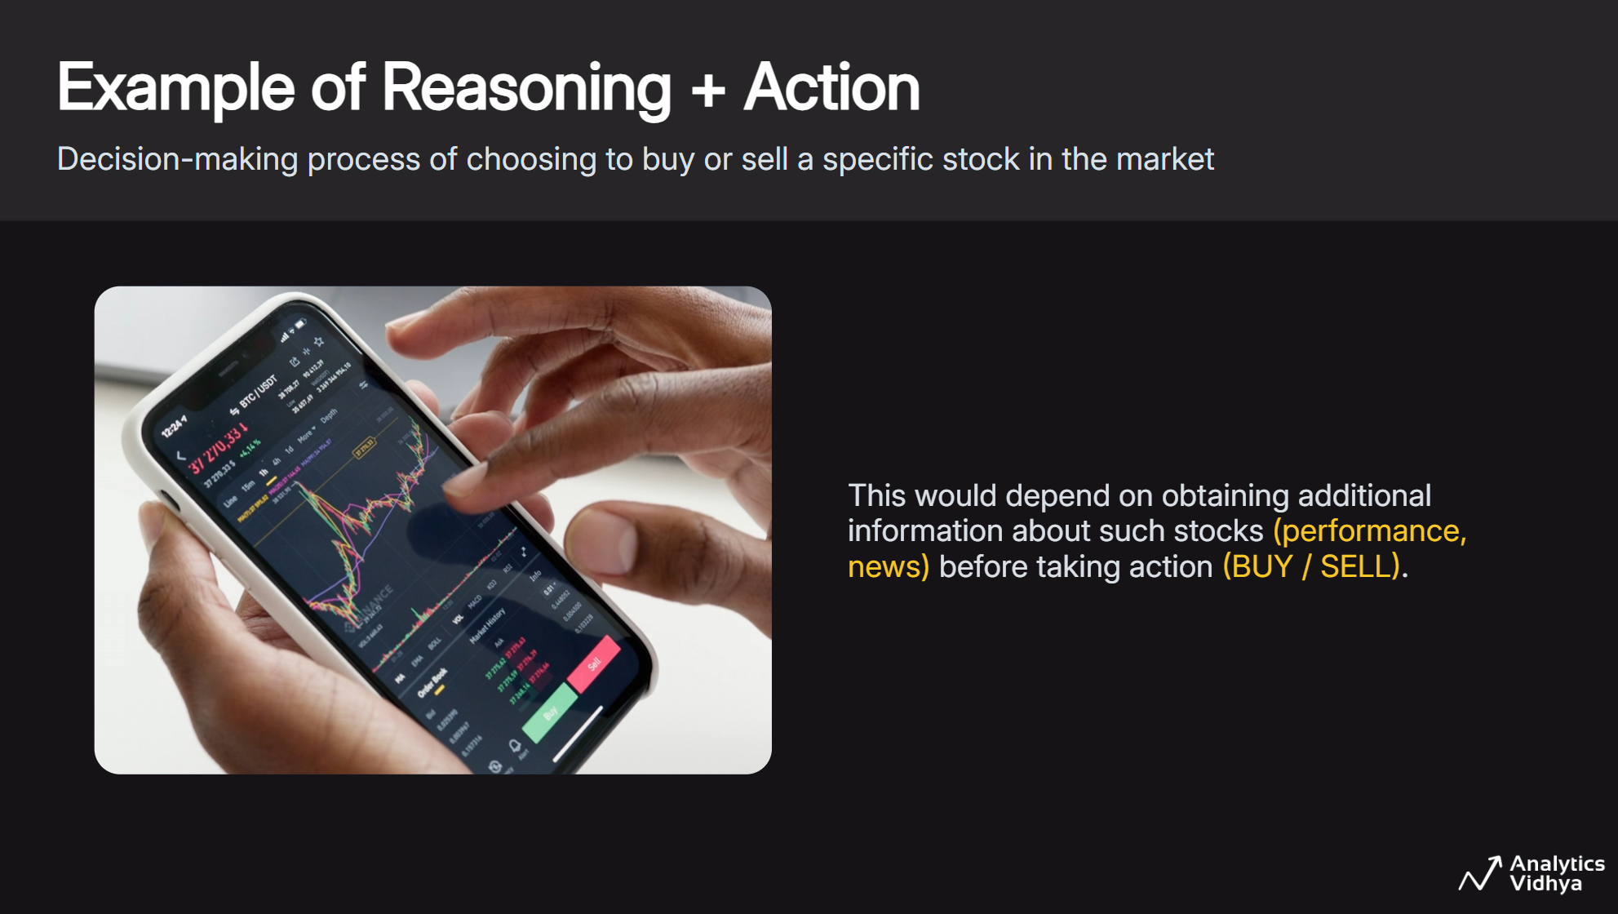

Slide 6
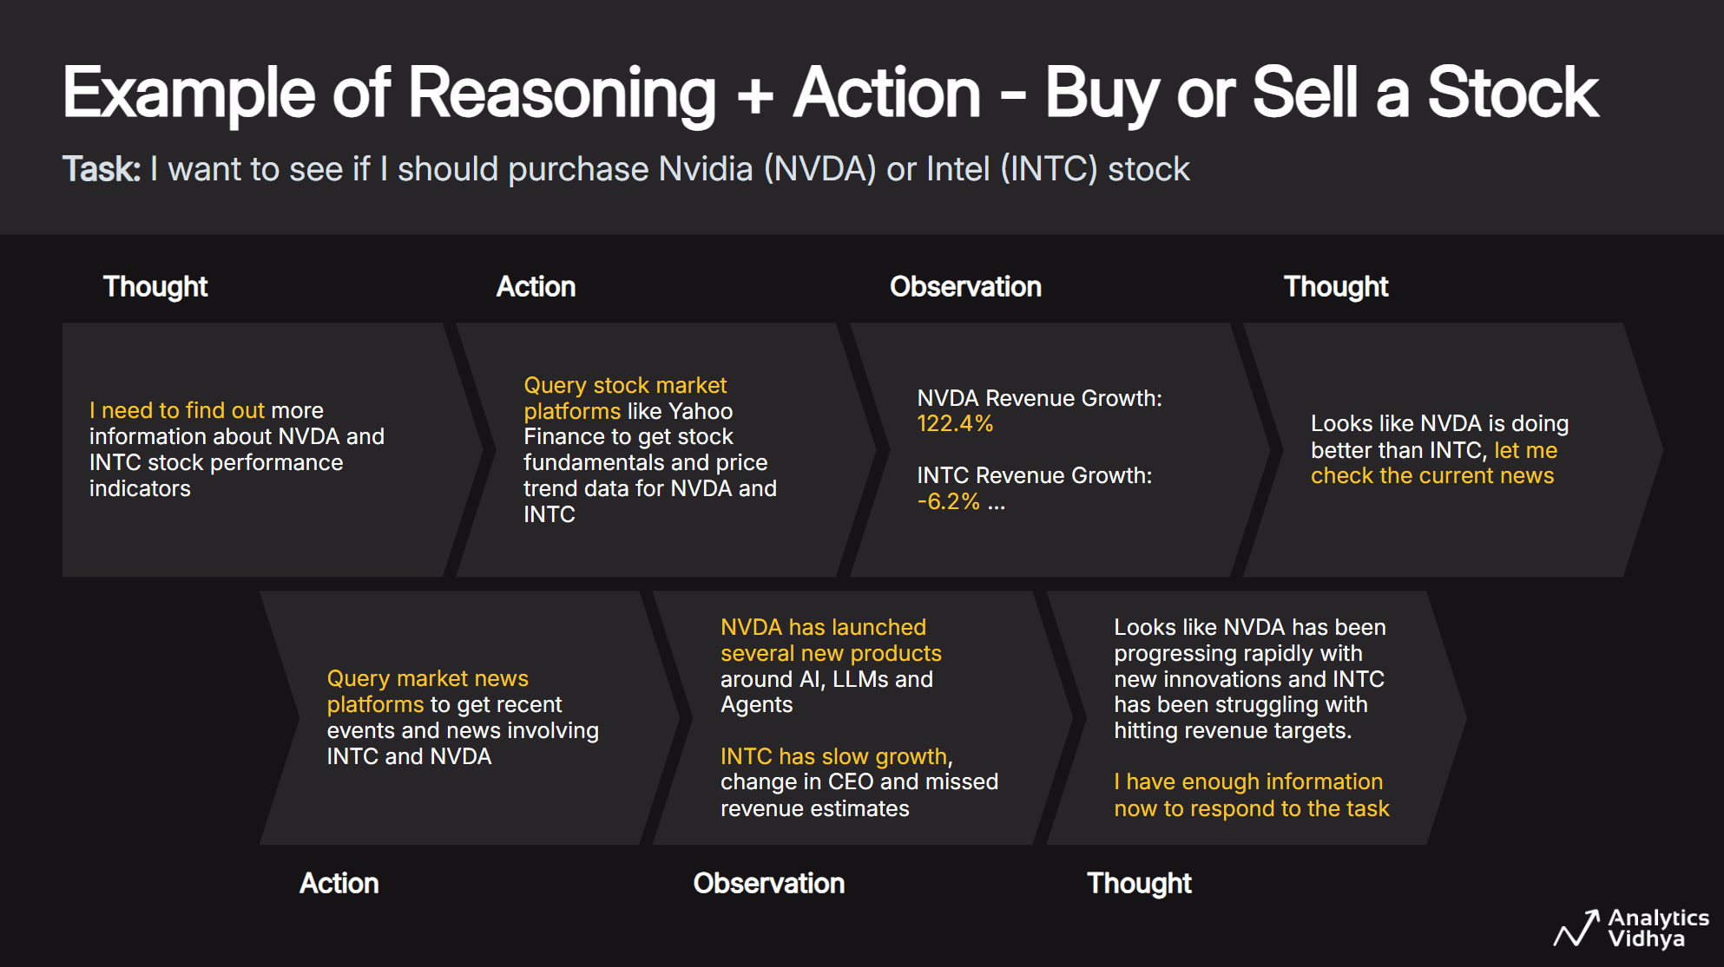

Slide 7
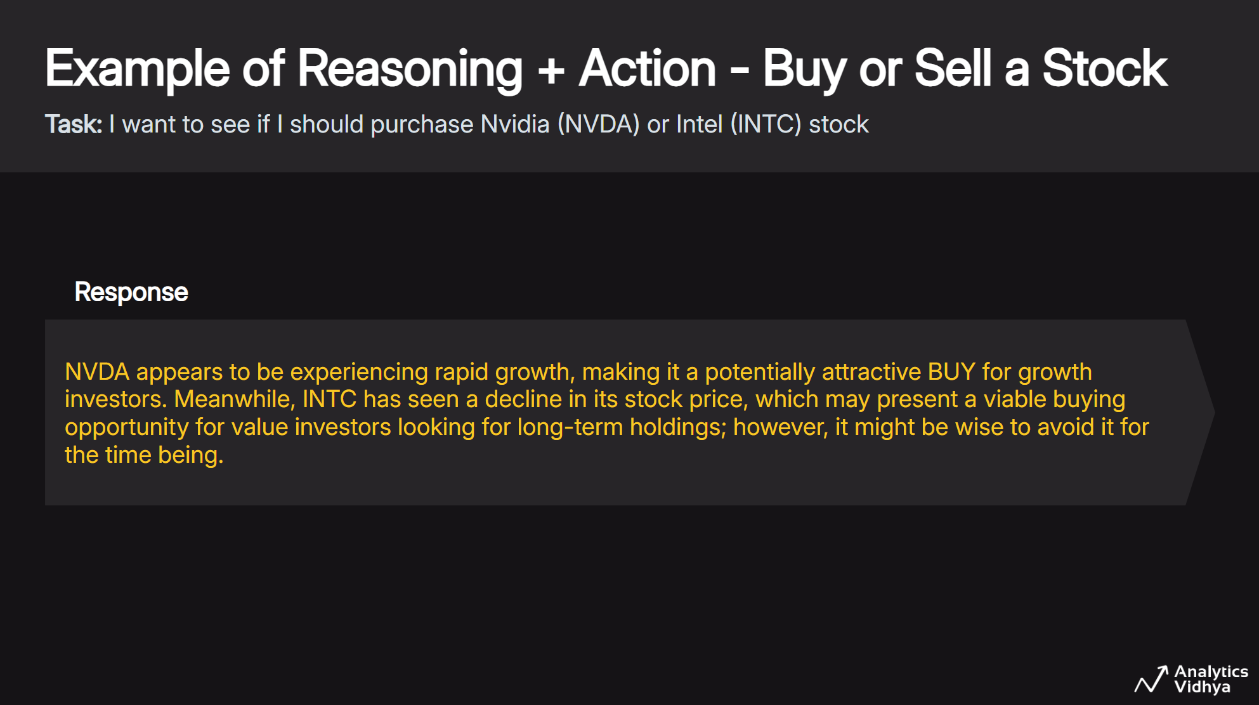

Slide 8
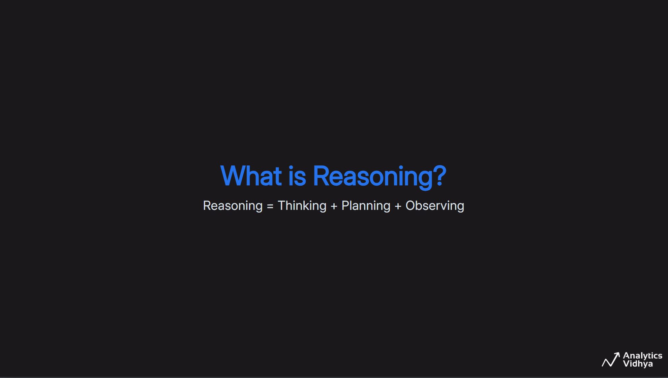

Slide 9
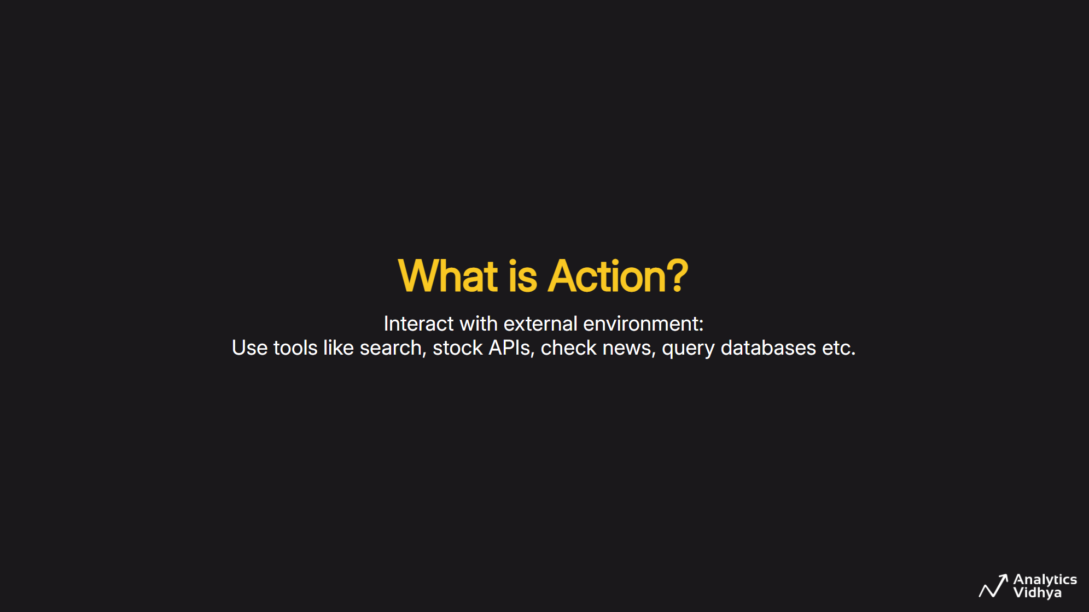

Slide 10
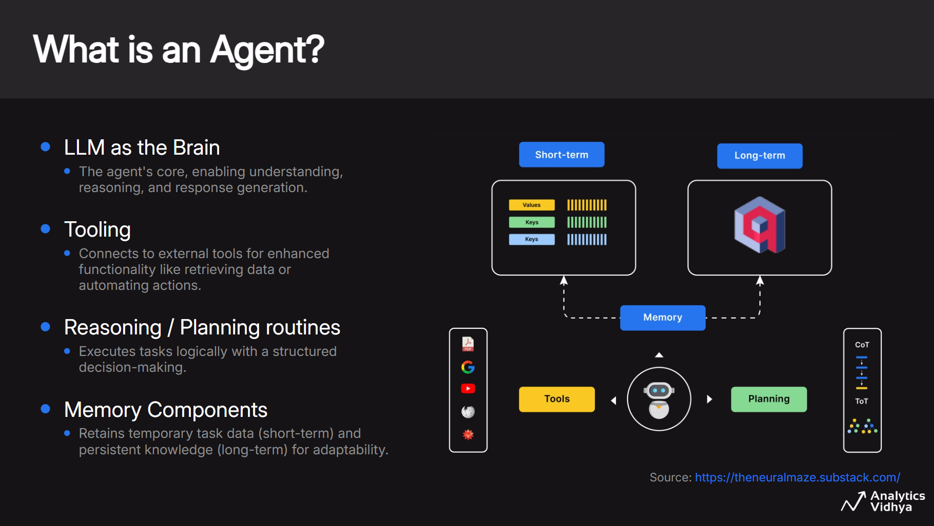

Slide 11
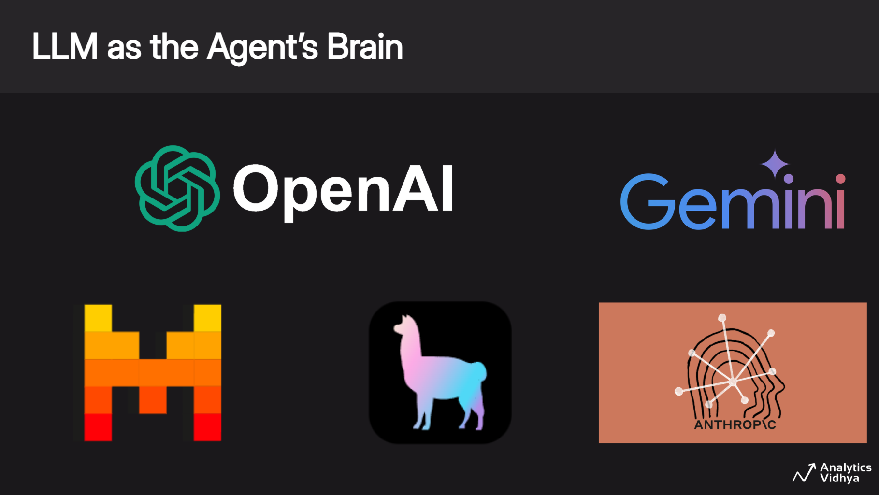

Slide 12
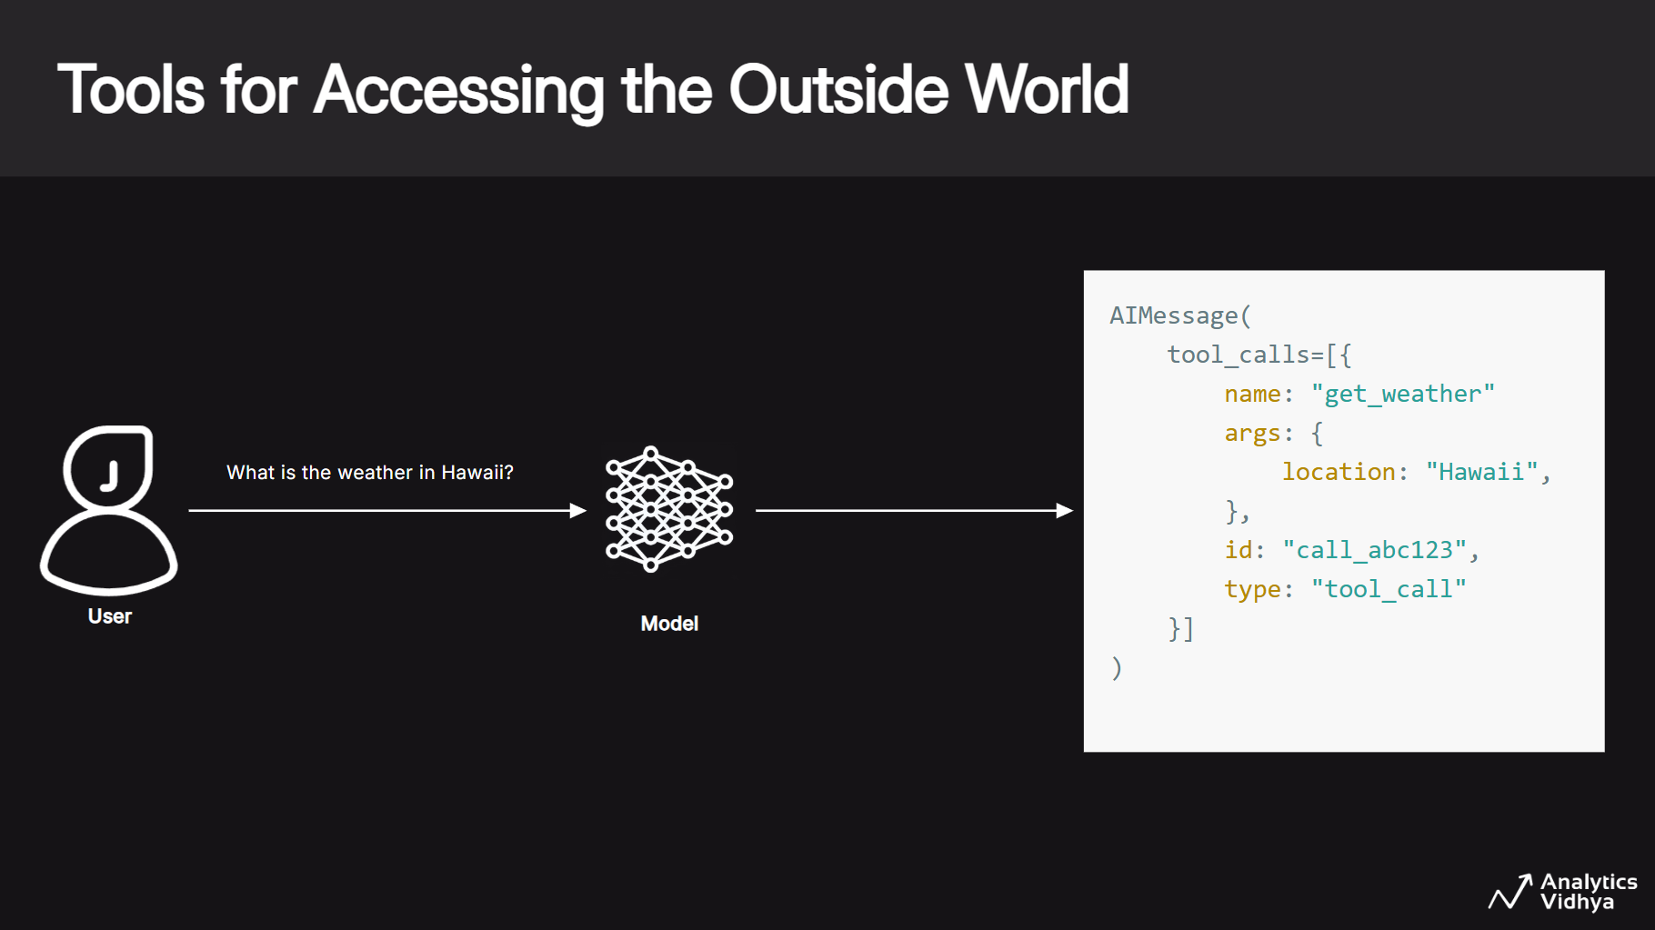

Slide 13
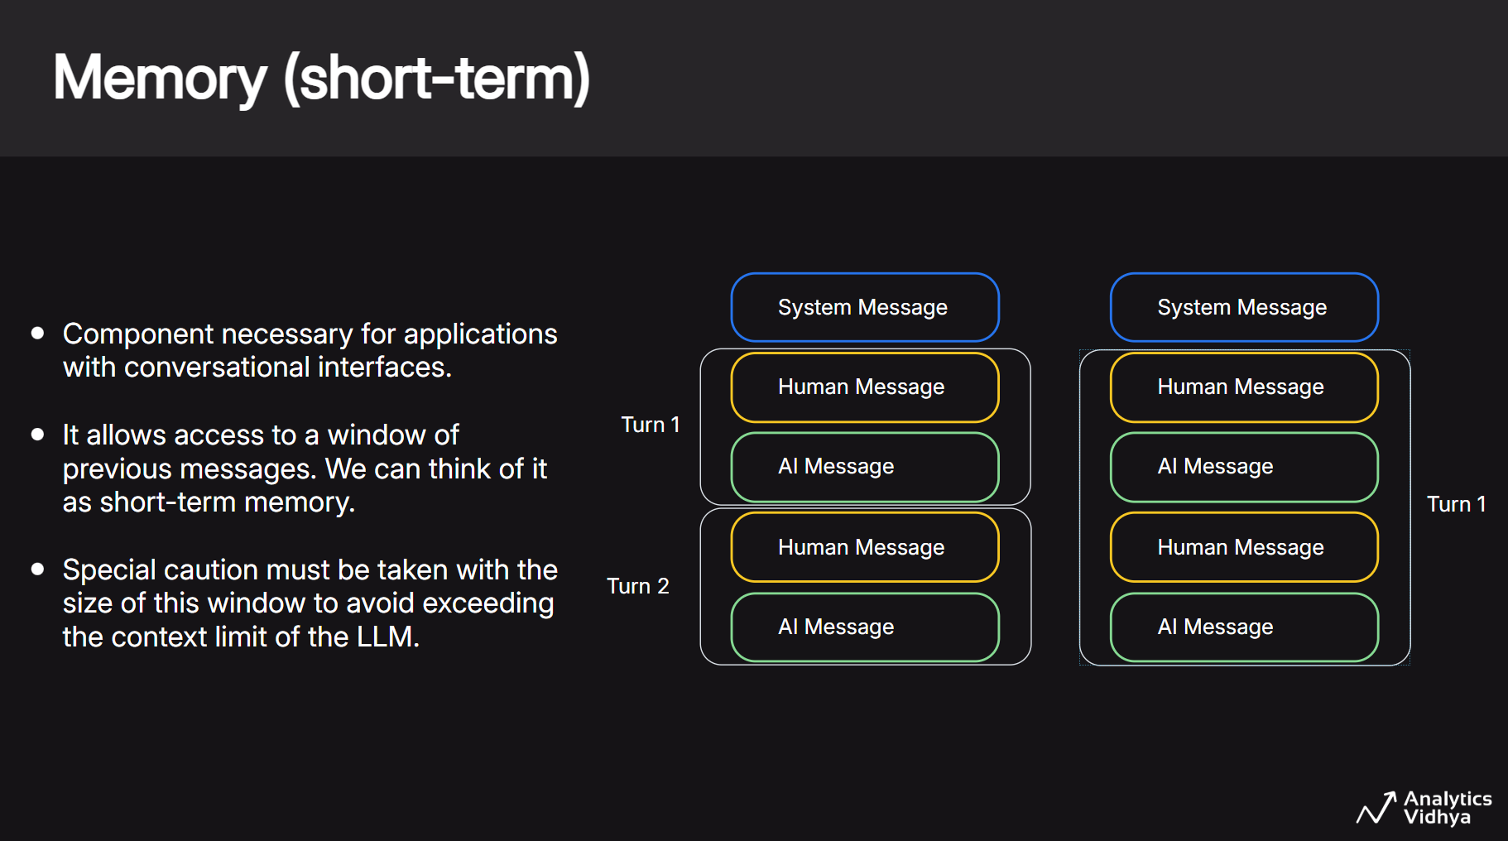

Slide 14
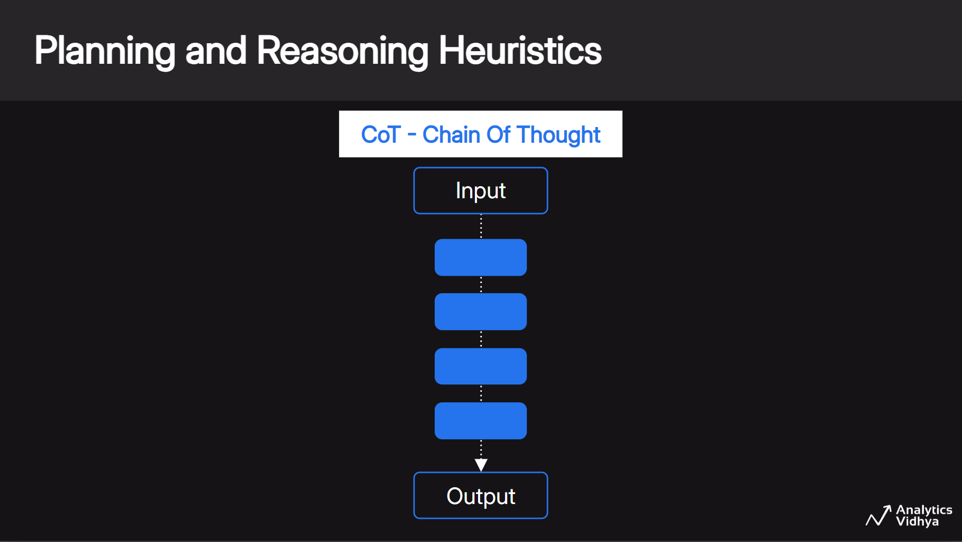

Slide 15
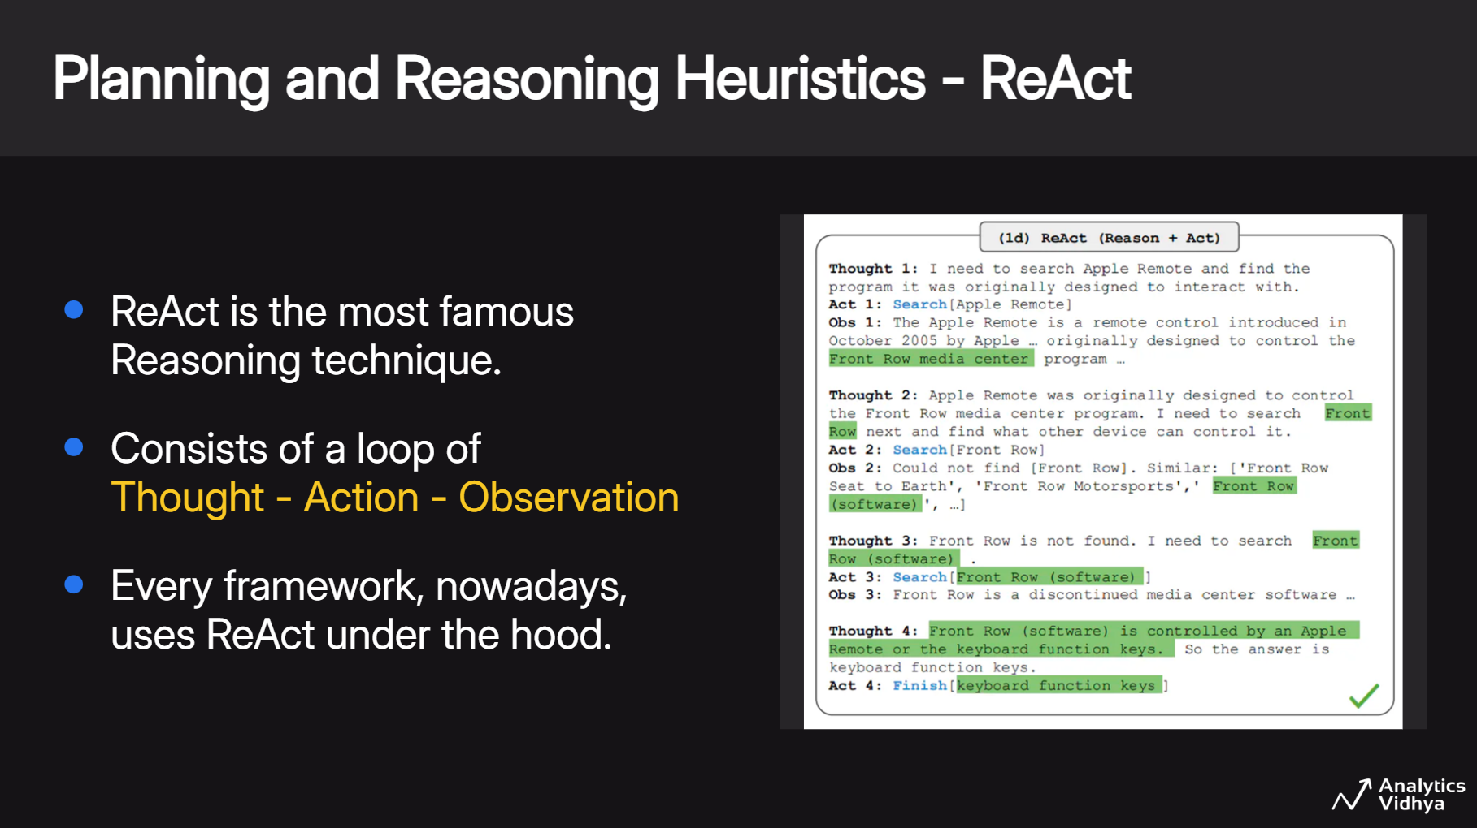

Slide 16
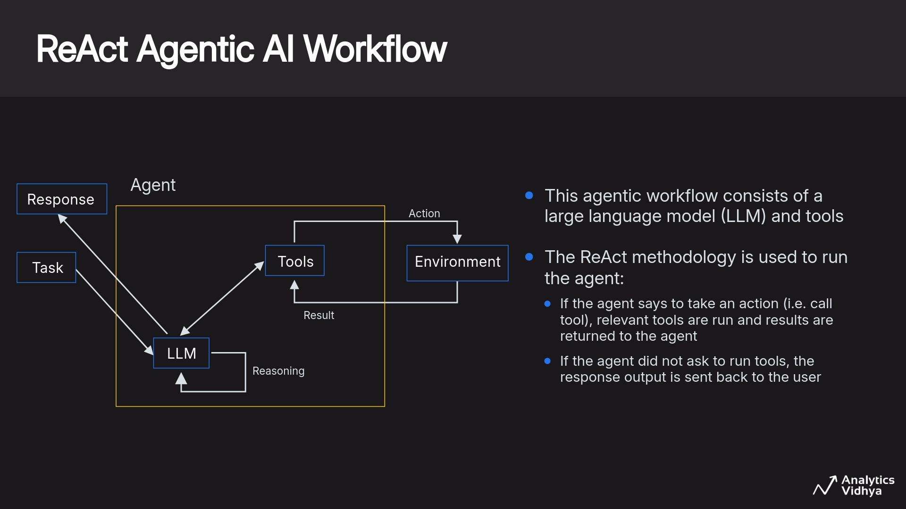

Slide 17
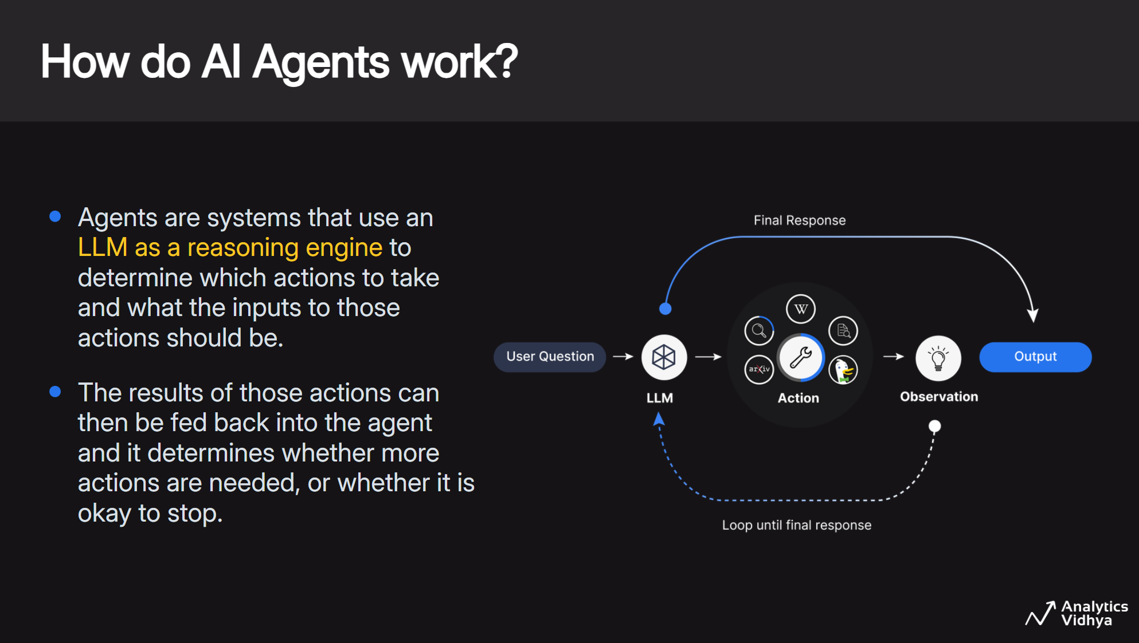

Slide 18
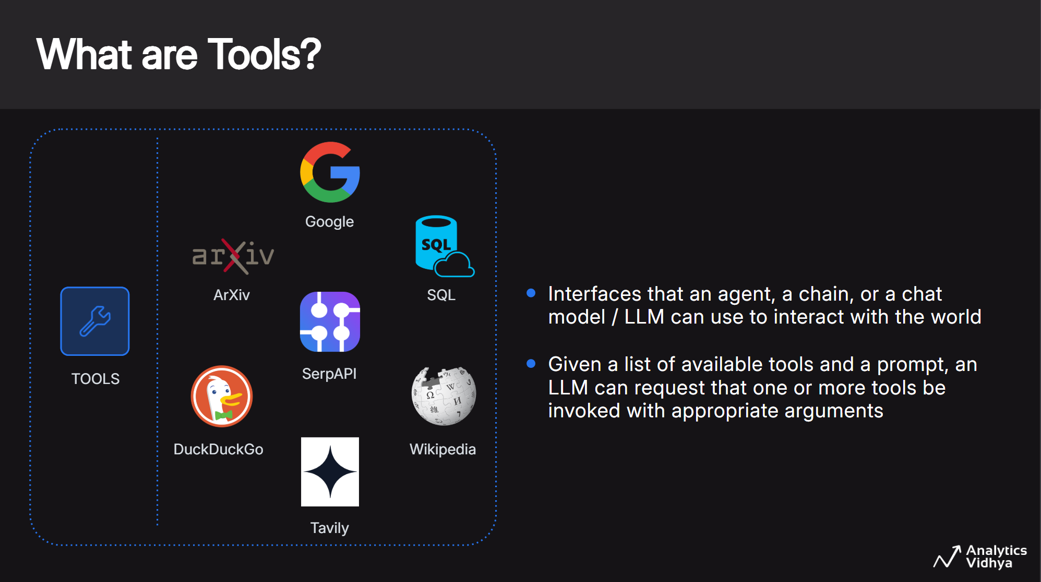

Slide 19
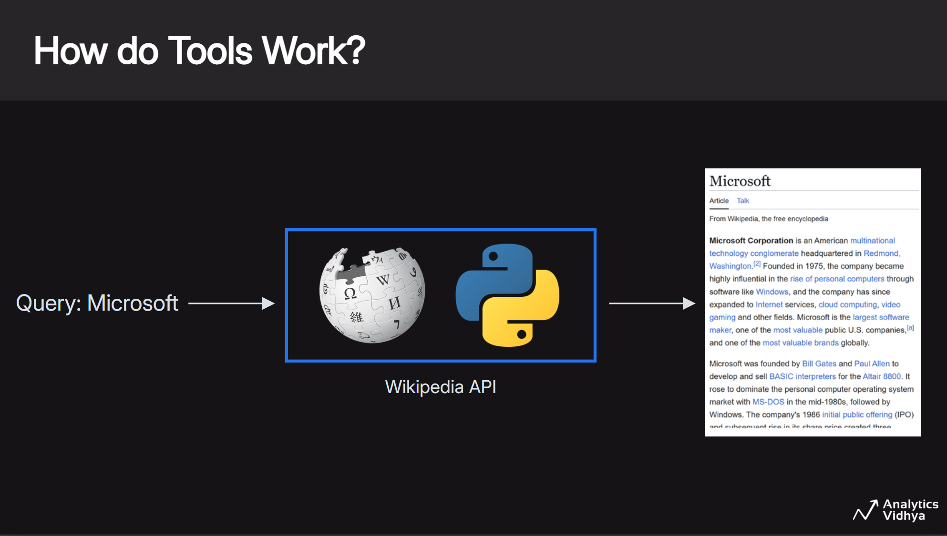

Slide 20
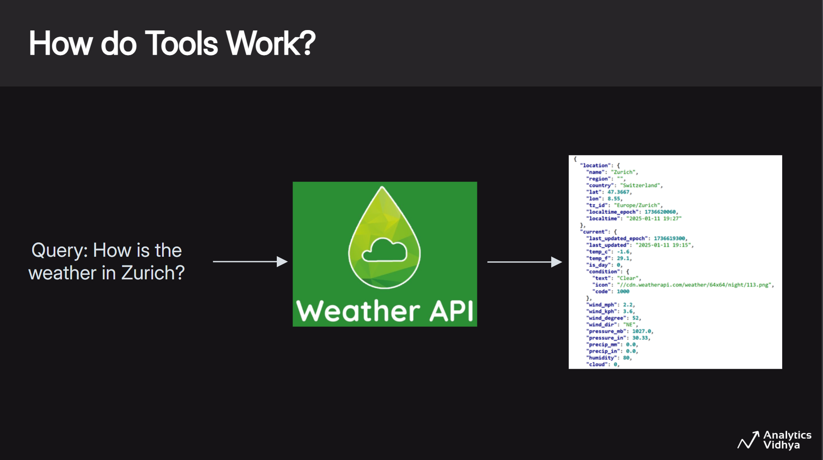

Slide 21
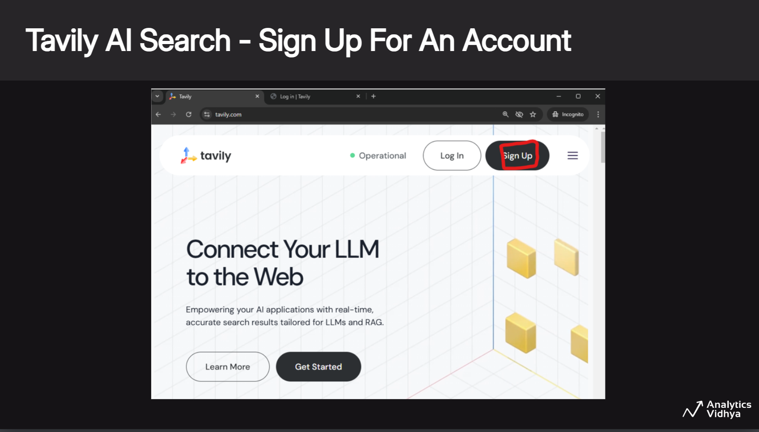

Slide 22
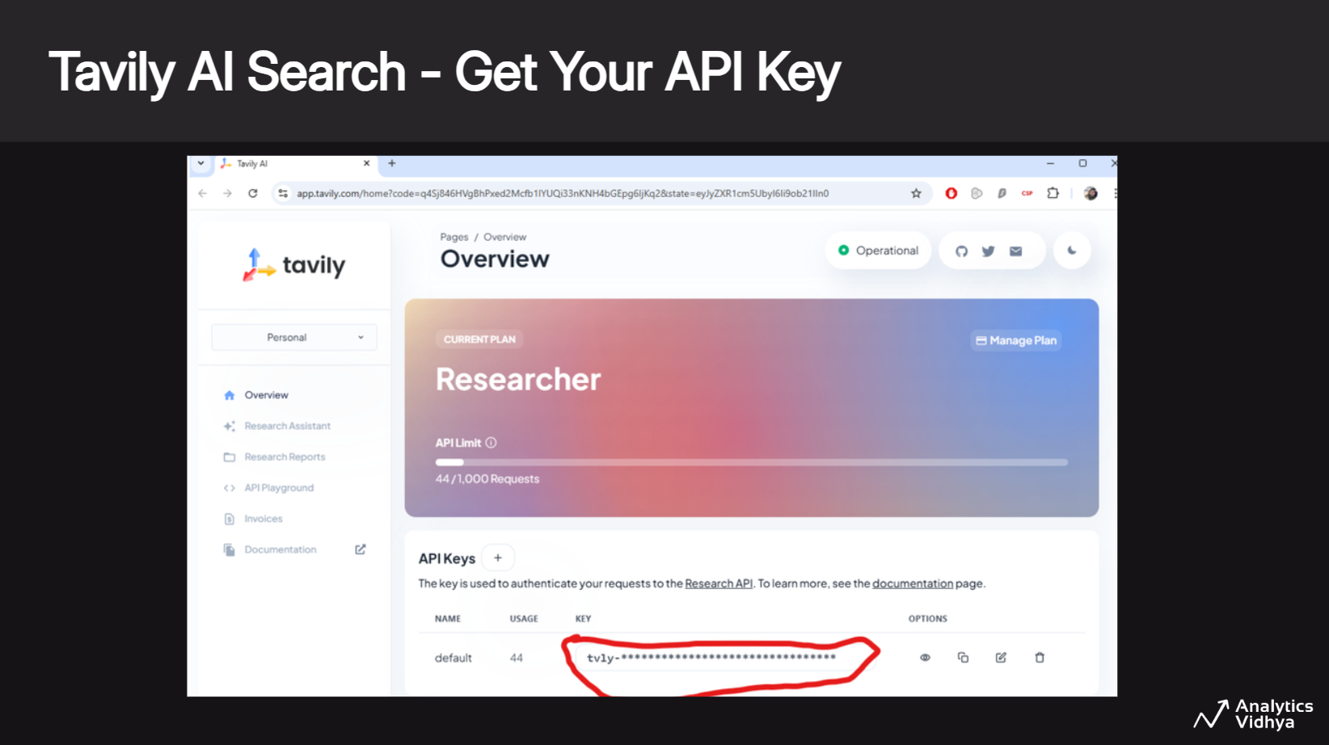

Slide 23
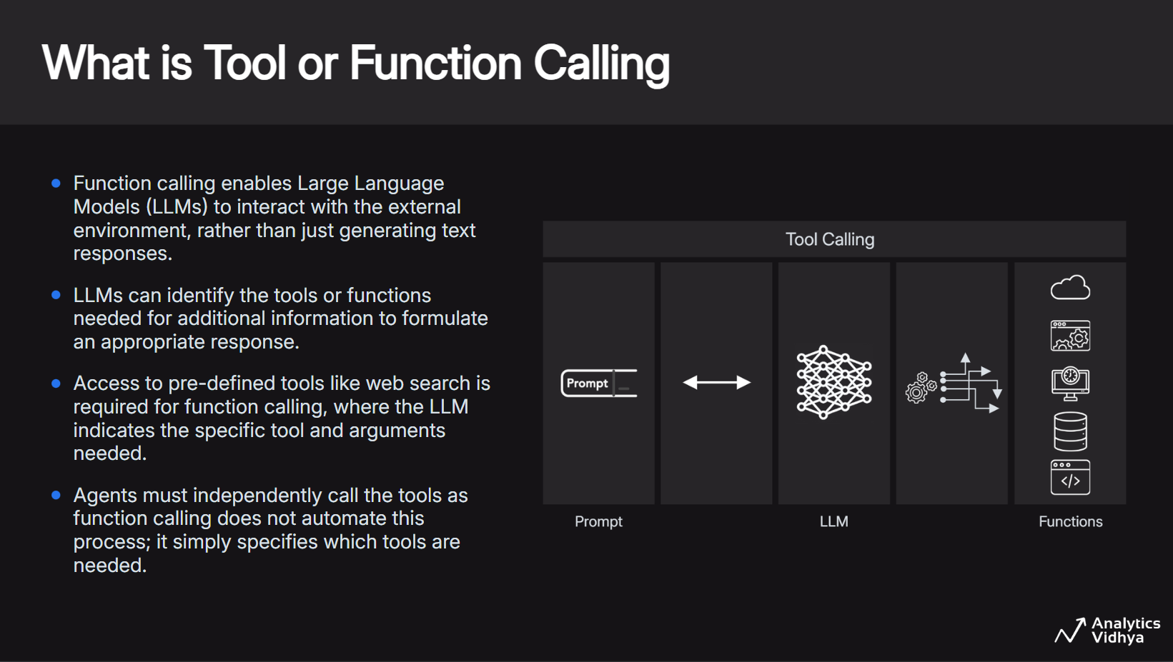

Slide 24
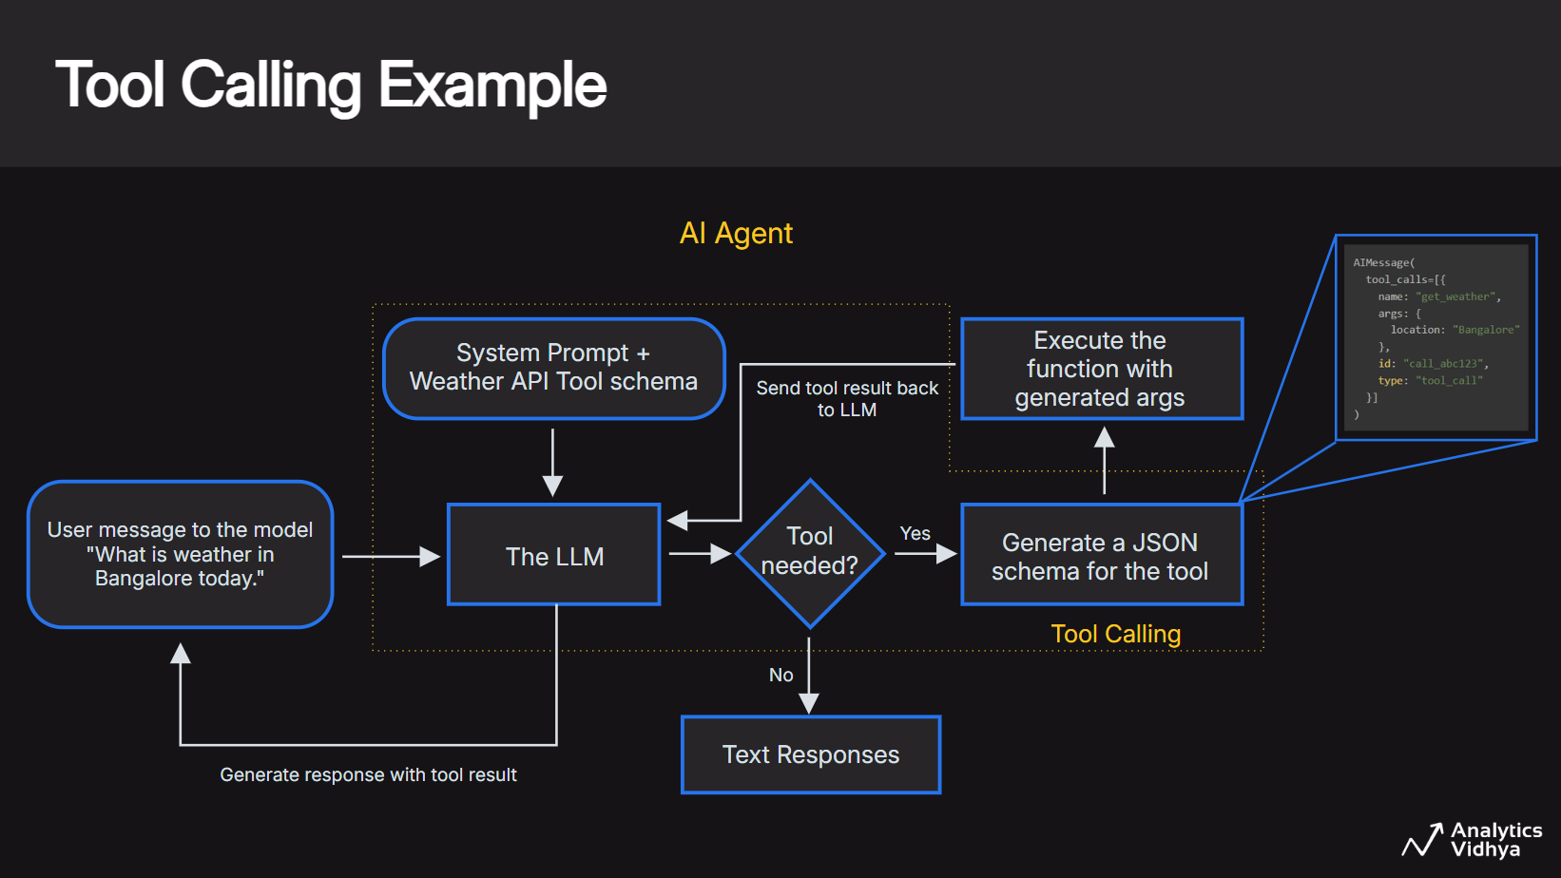

Slide 25
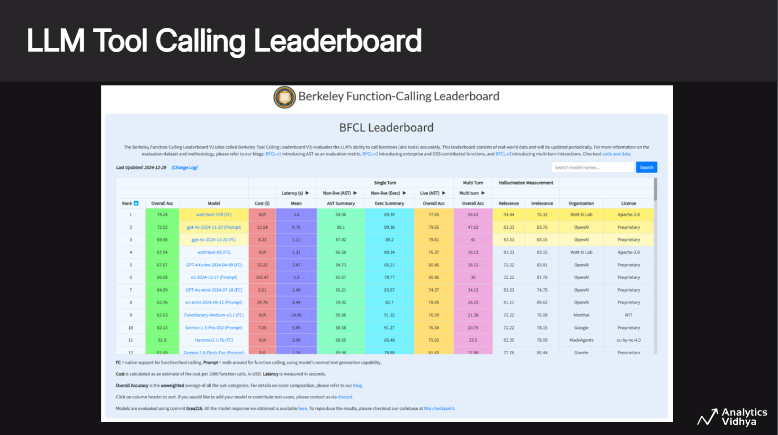

Slide 26
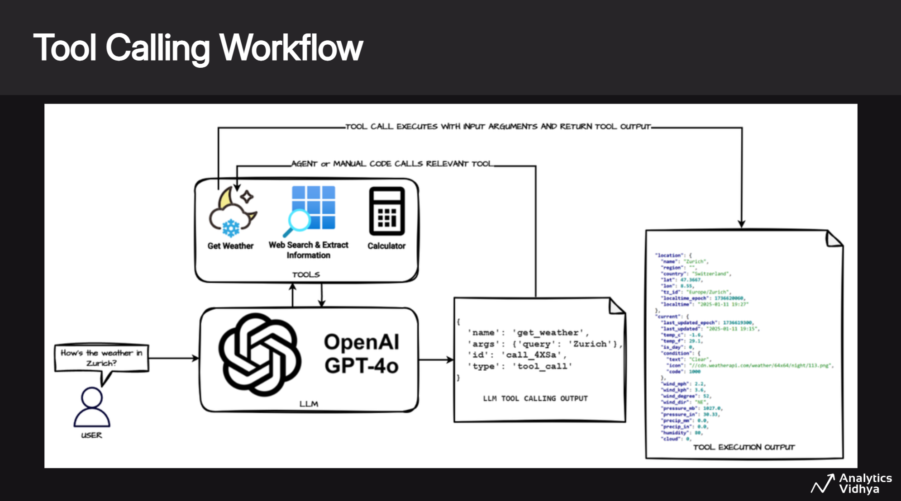
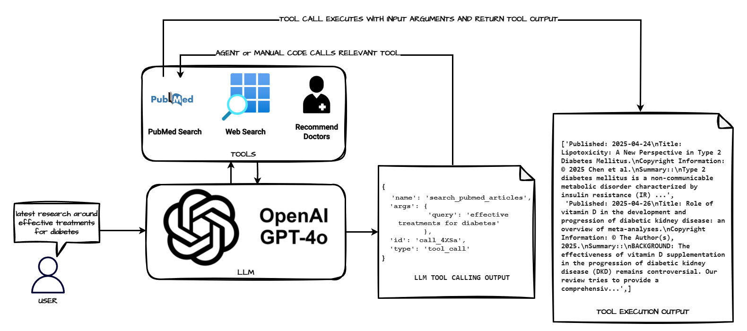

Slide 27
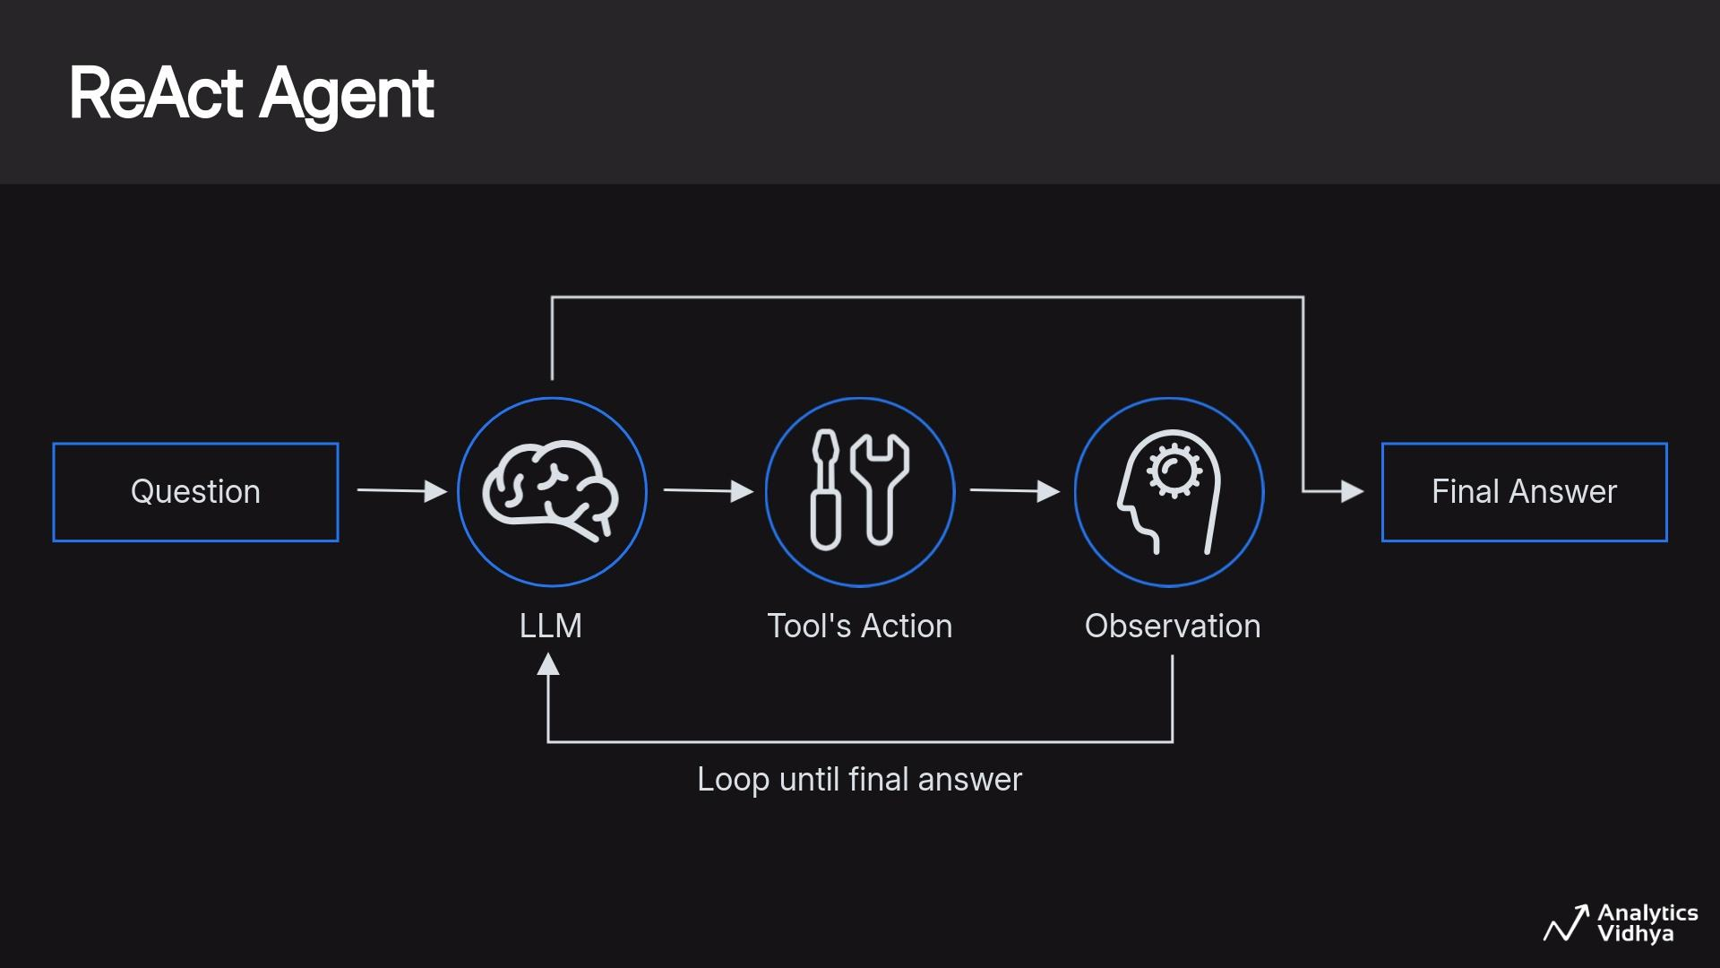

Slide 28
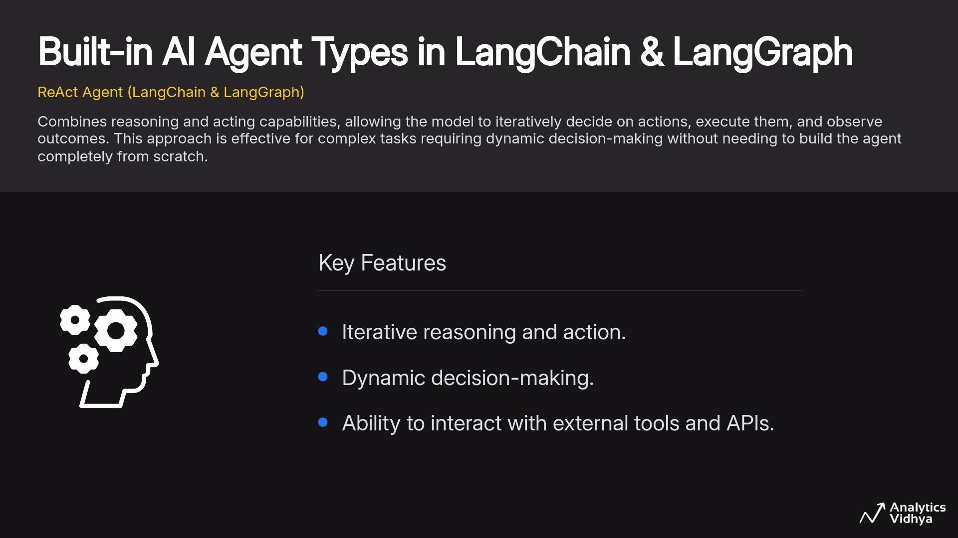

Slide 29
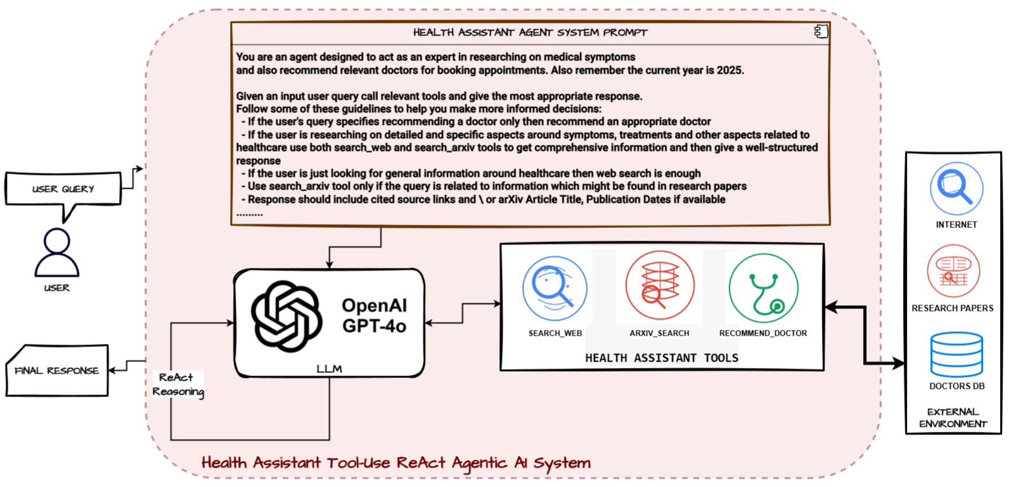
ReAct Agent Architecture - LangChain \ LangGraph

Slide 30
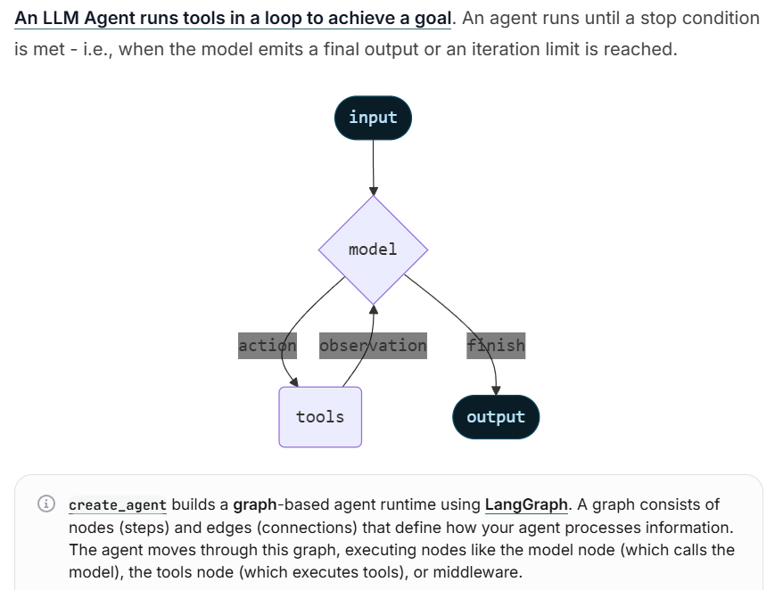
Notes for the Future
When using LangChain > 1.0 (newest version as of Nov, 2025) - prefer using create_agent from langchain.agents vs create_react_agent from langgraph.prebuilt
Refer to the official migration guide for more details
Recommendation: Do NOT update your current library versions especially in production (wait for it to become stable - 1-2 months minimum)

Slide 31

Demo 1
Build a Tool-Use ReAct Agentic AI System with LangChain/LangGraph
Creating Tools from Scratch
Tool-Calling + Built-in ReAct Agentic Flows
Get the notebook from HERE
Run it on Colab by copying to your drive or local system & follow along with the instructor
Recommended to run on Google Colab

Slide 32
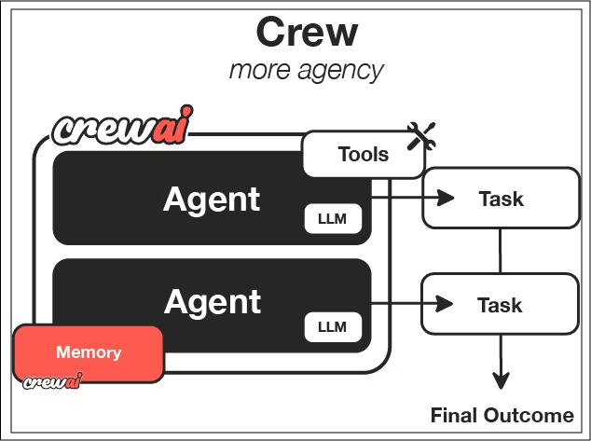
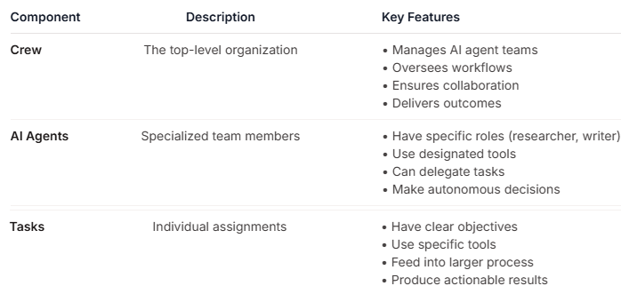
Agentic AI Systems with CrewAI

Slide 33
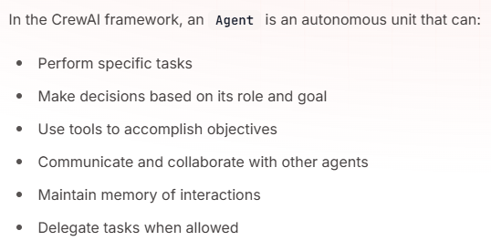
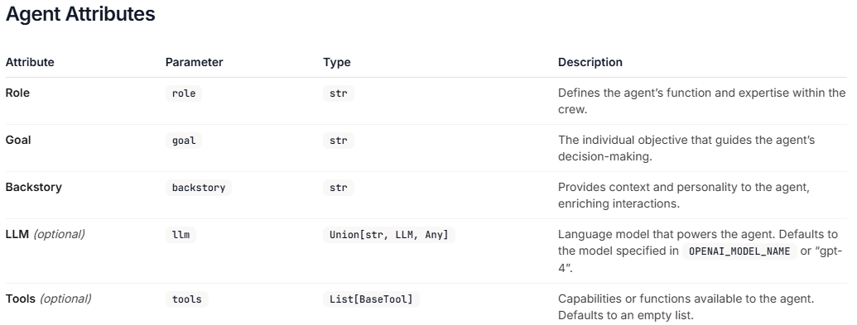
Agentic AI Systems with CrewAI

Slide 34
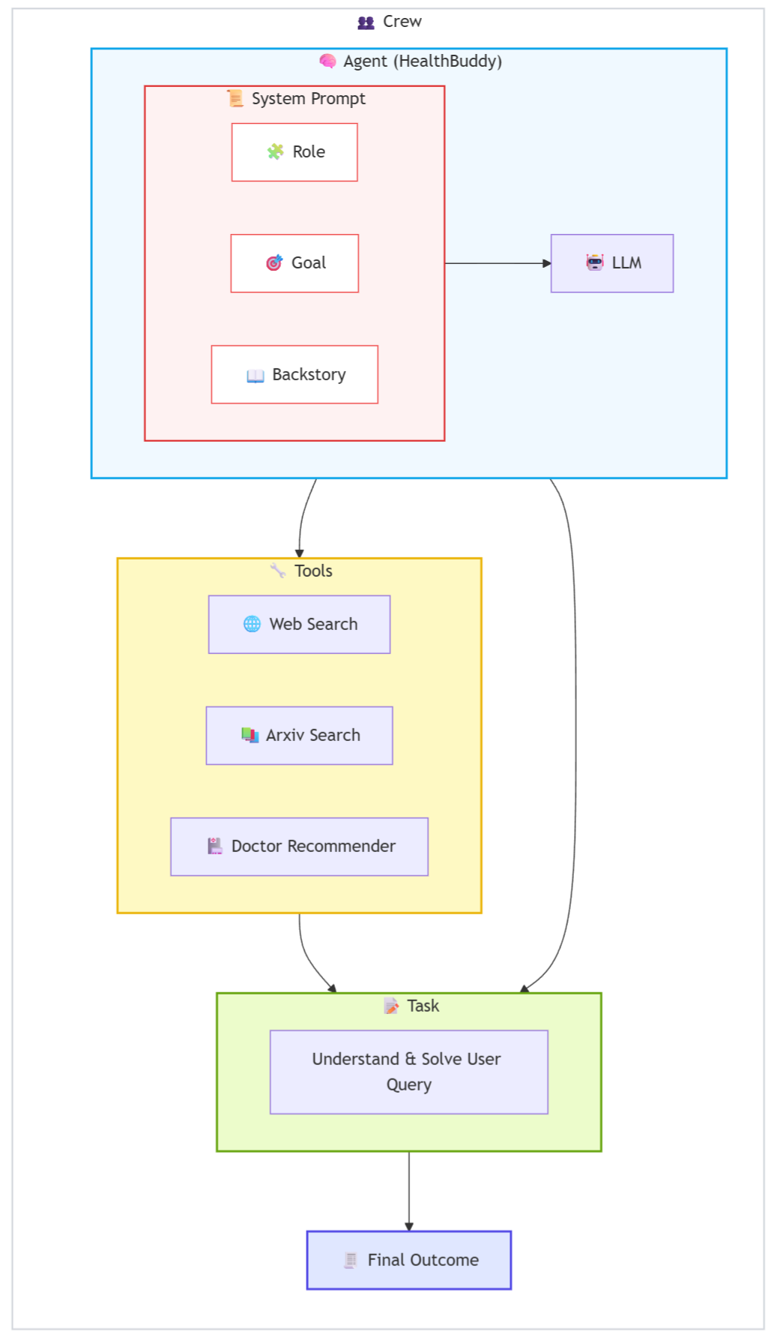
ReAct Agent Architecture - CrewAI

Slide 35
Demo 2
Build a Tool-Use ReAct Agentic AI System with CrewAI
Creating Tools from Scratch
Tool-Calling + Built-in ReAct Agentic Flows
Get the notebook from HERE
Run it on Colab by copying to your drive or local system & follow along with the instructor
Recommended to run on Google Colab

Slide 36
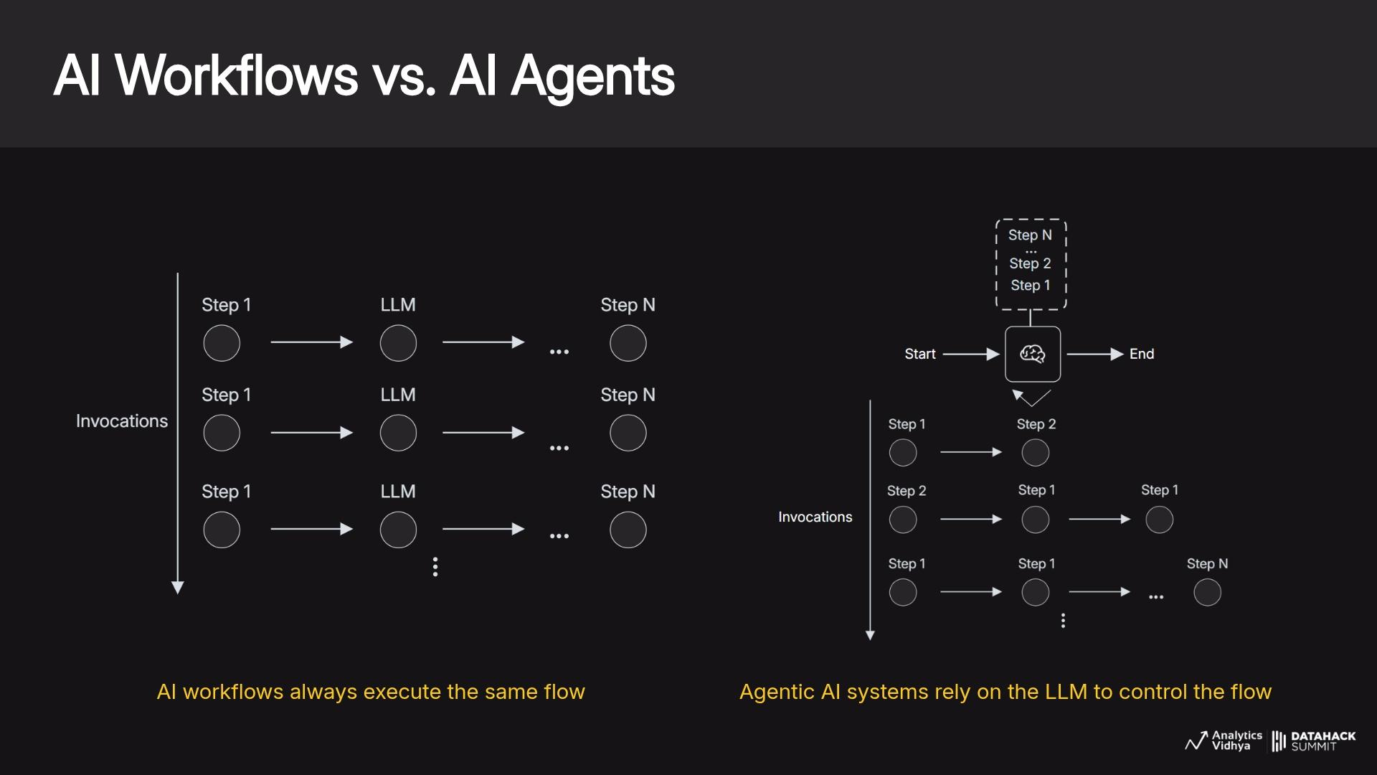

Slide 37
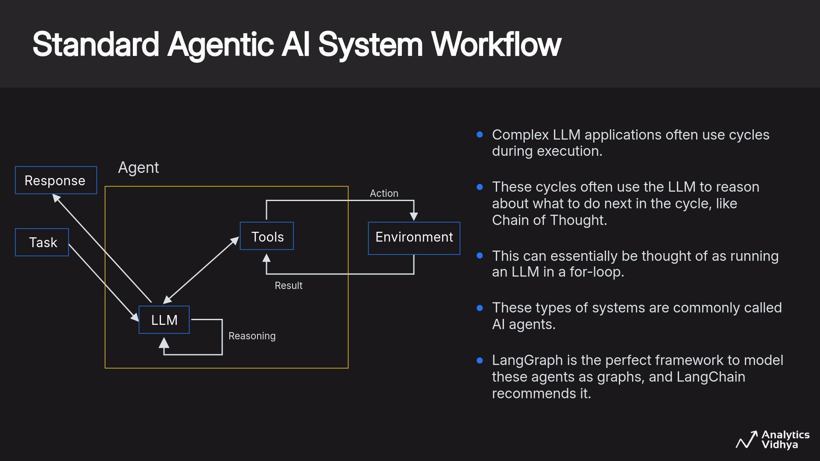

Slide 38
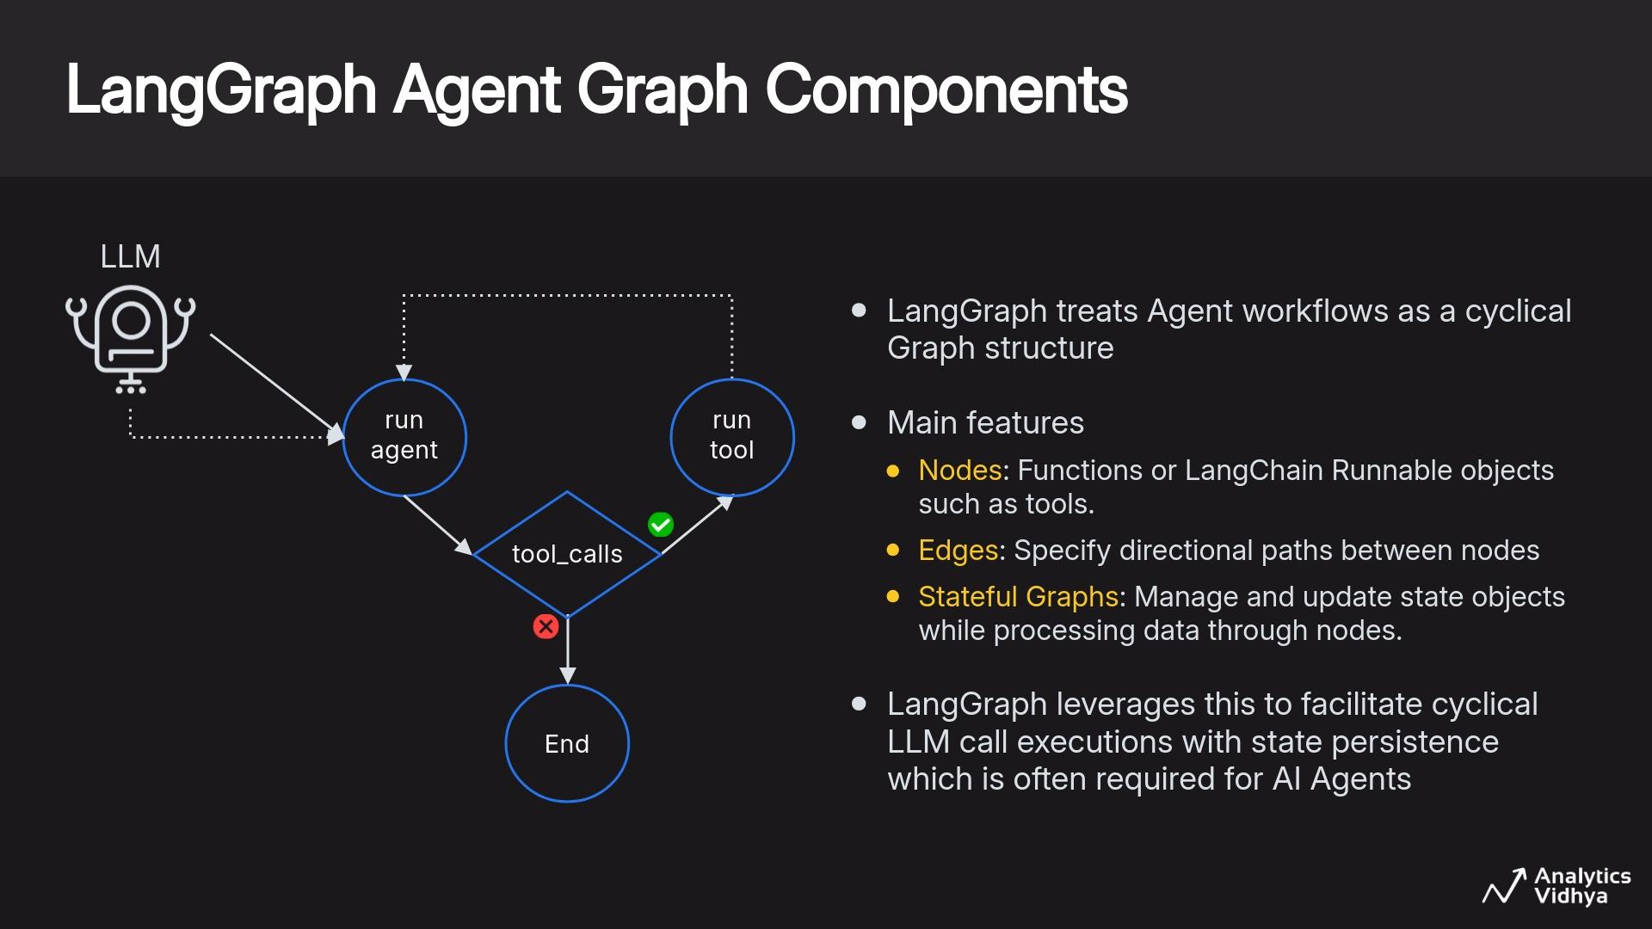

Slide 39
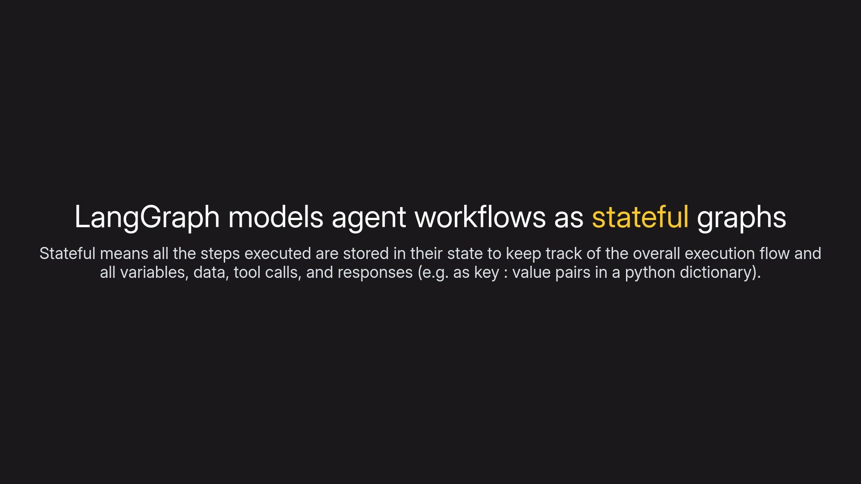

Slide 40
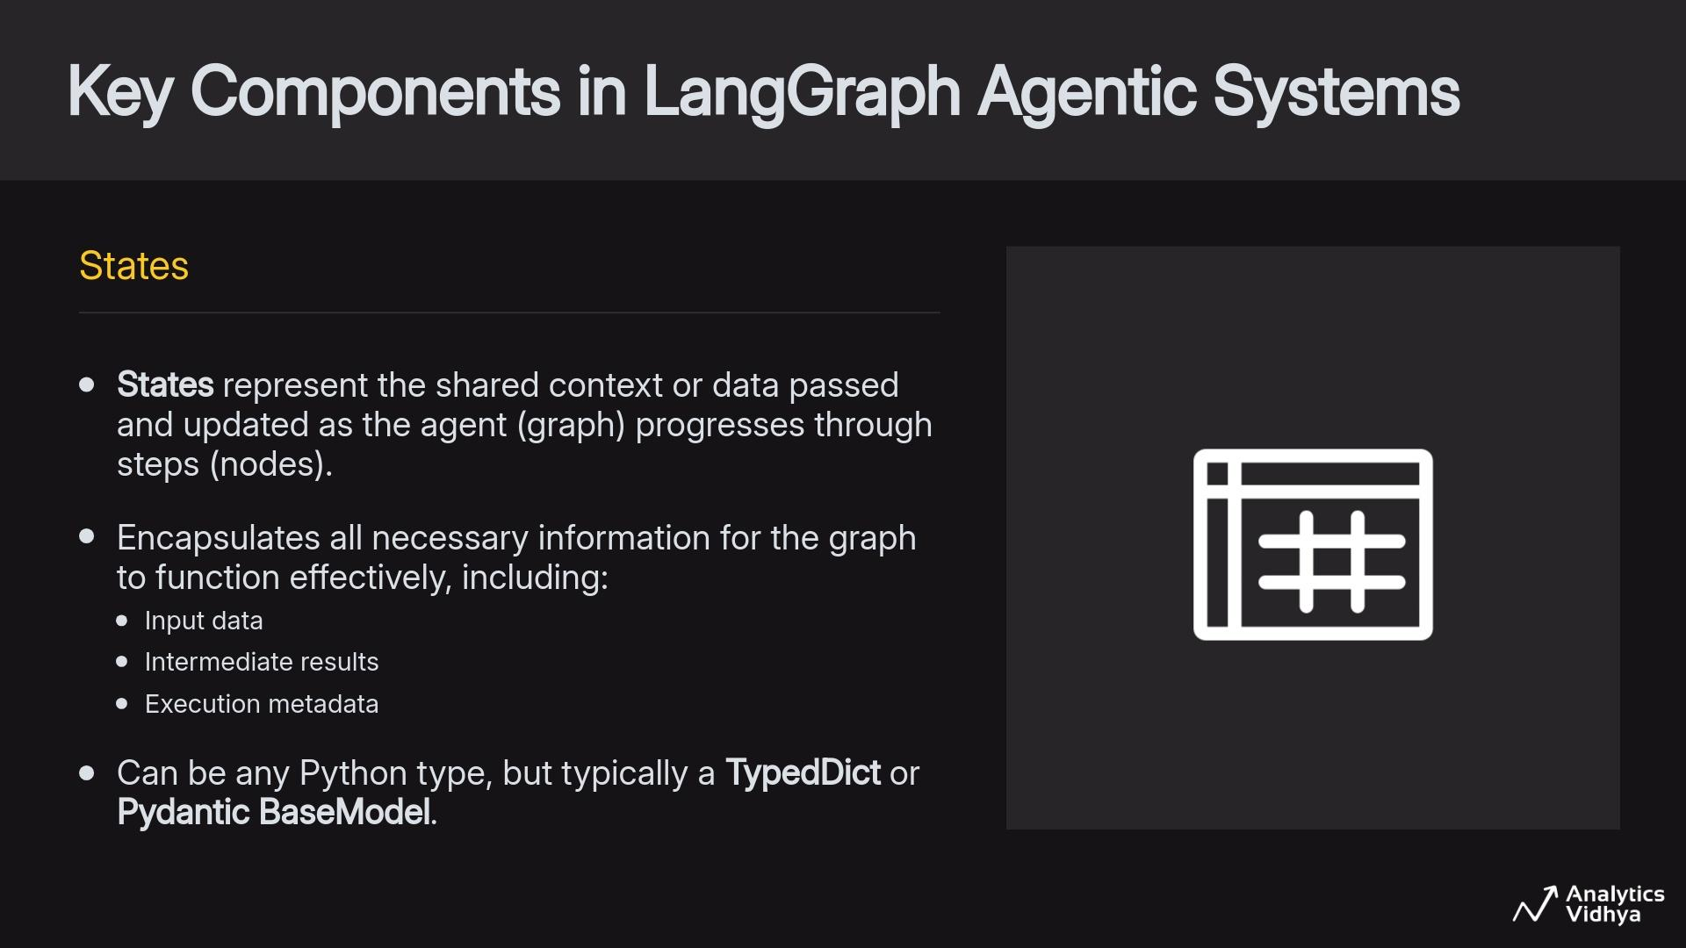

Slide 41
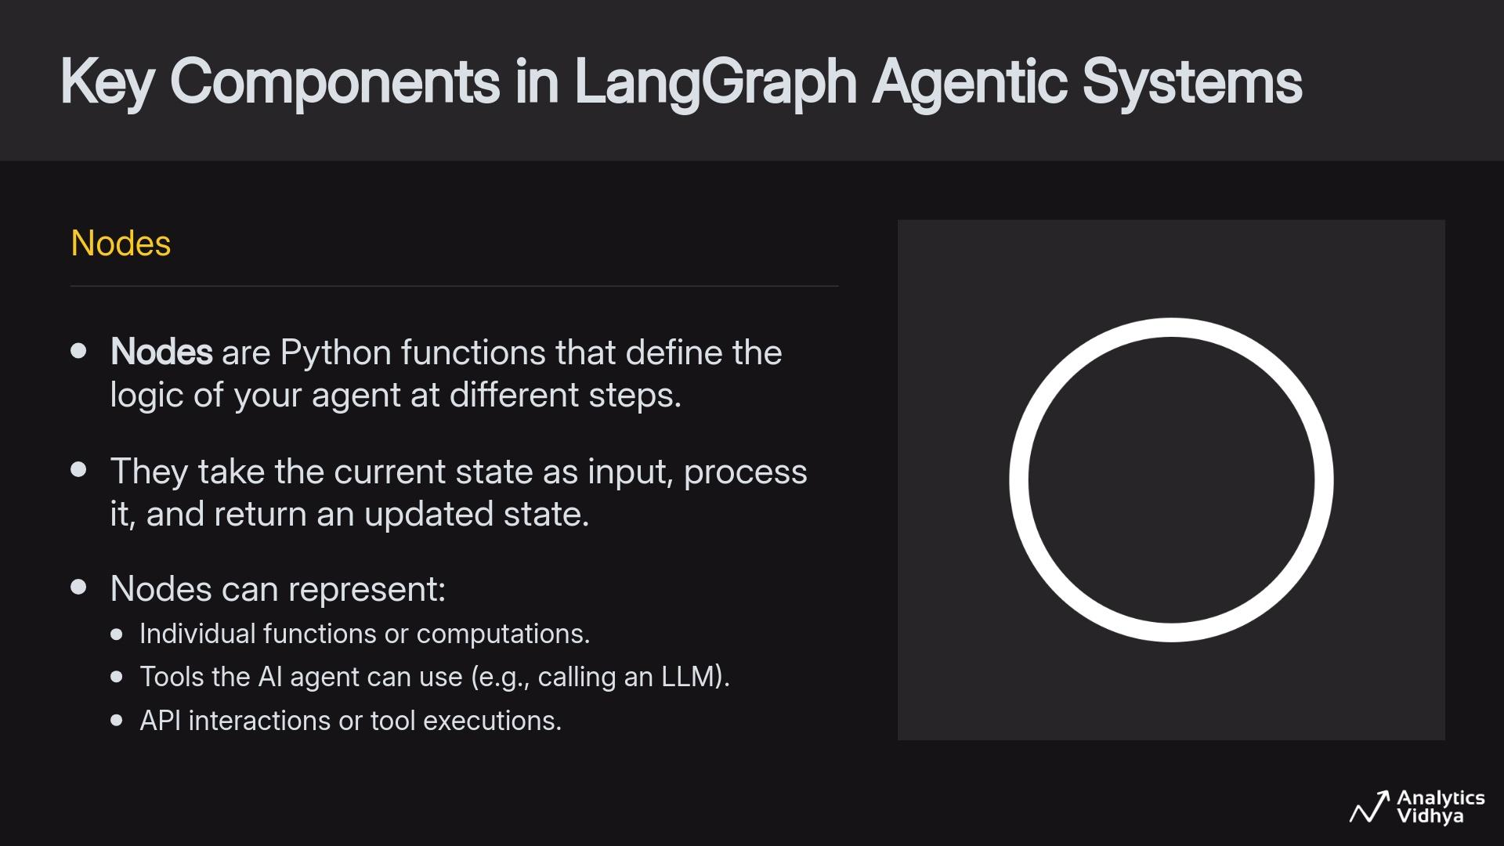

Slide 42
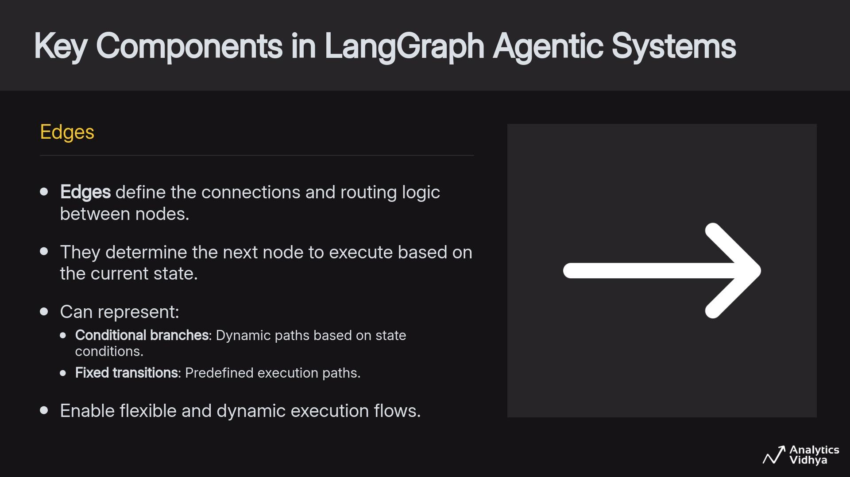

Slide 43
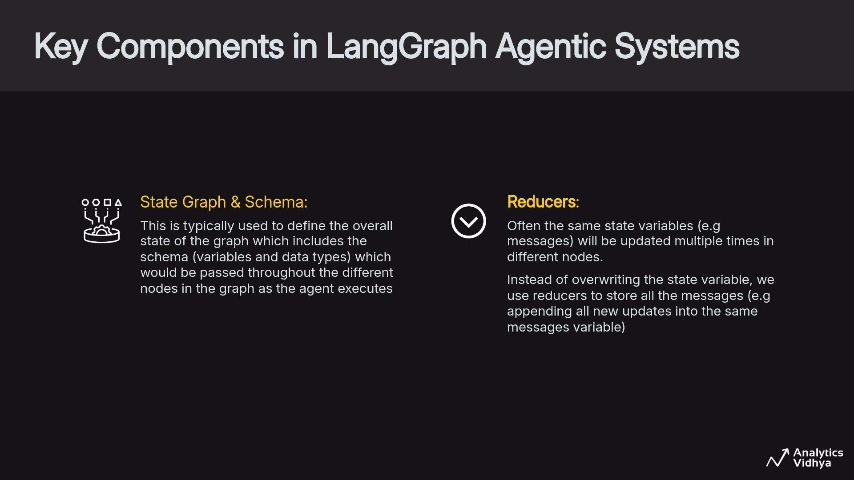

Slide 44
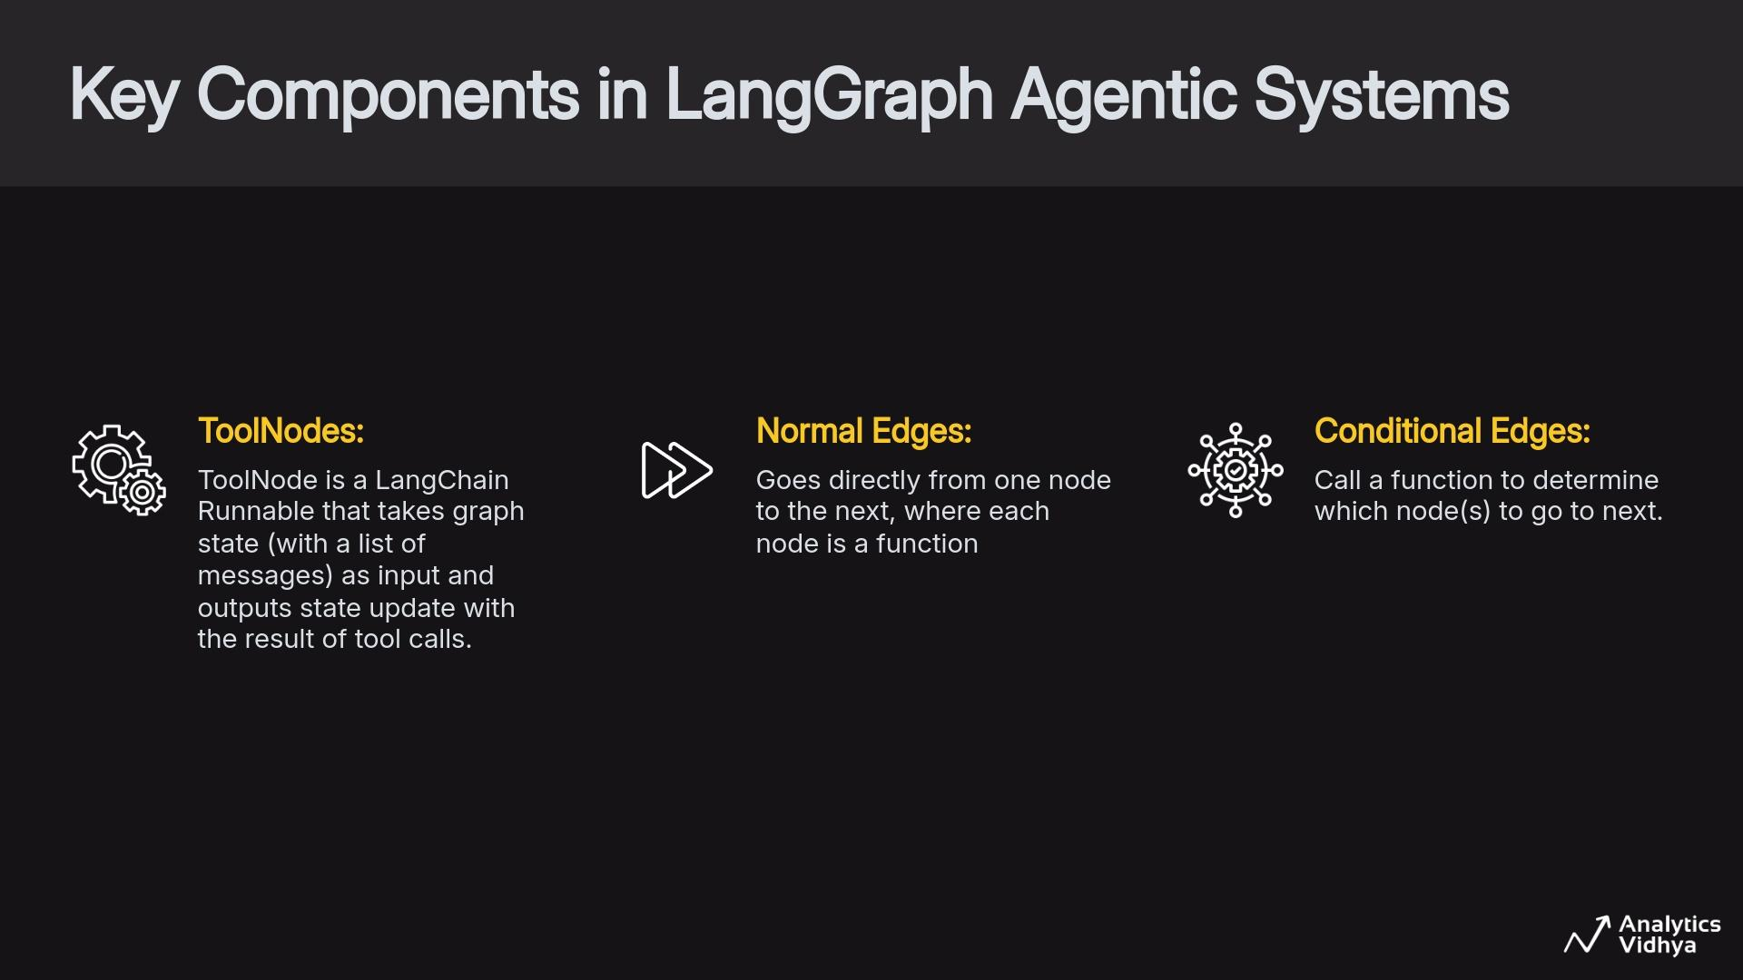

Slide 45
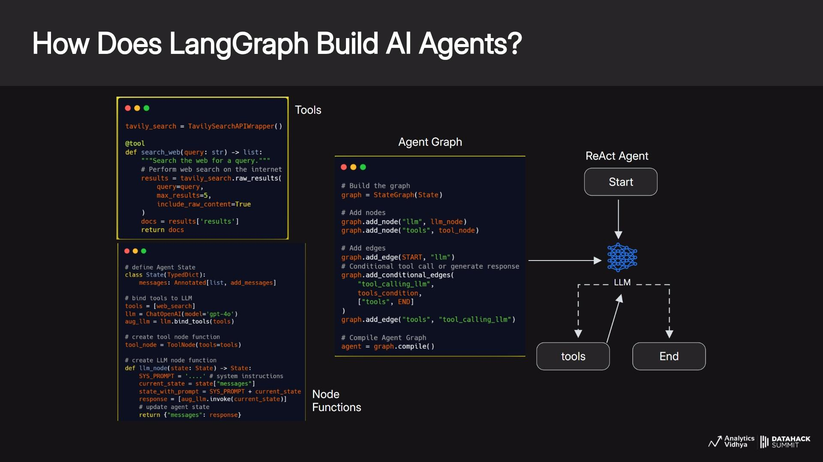

Slide 46
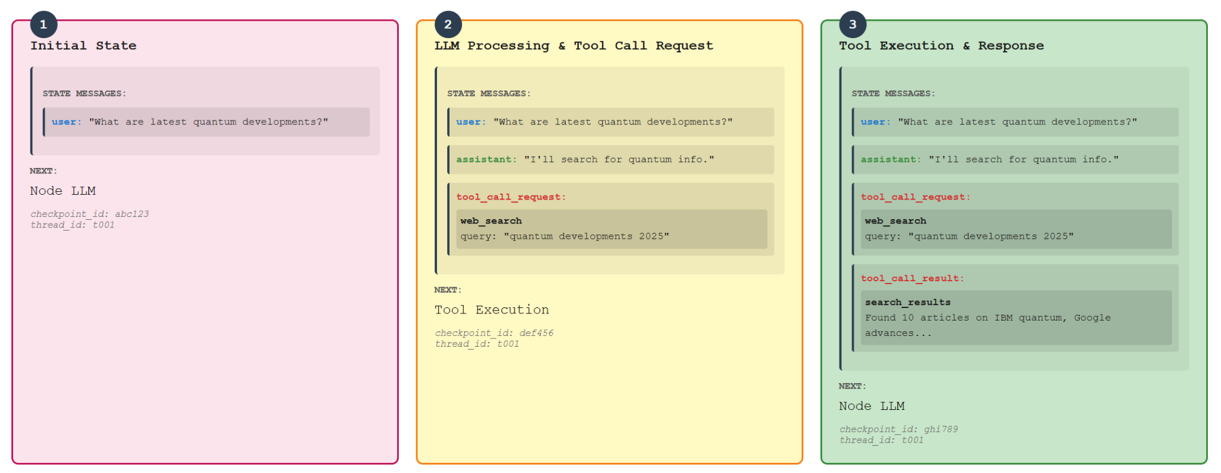
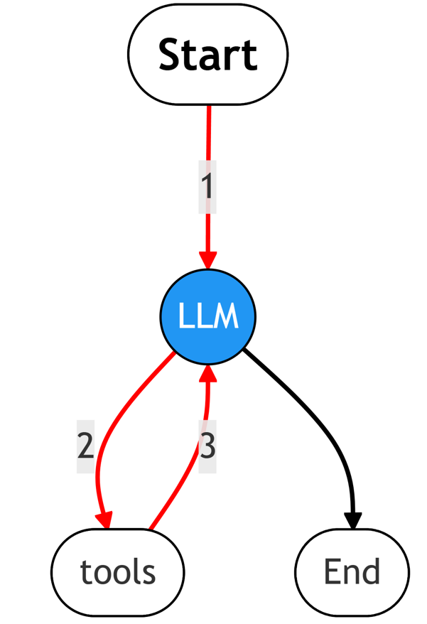

Slide 47
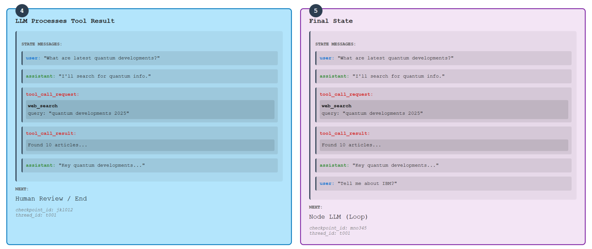
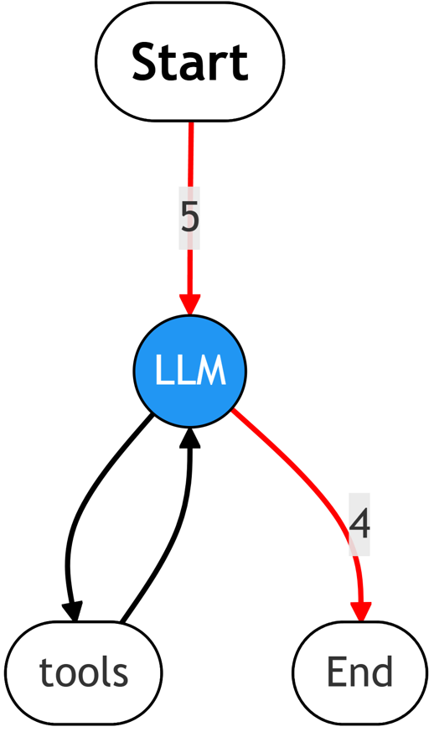

Slide 48
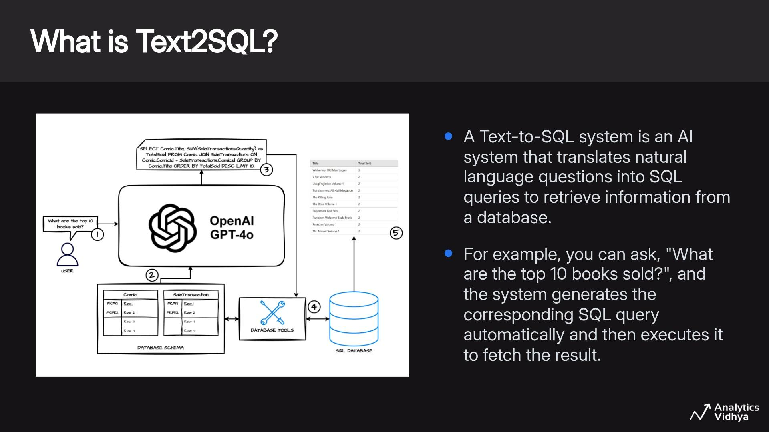

Slide 49


Slide 50


Our Database Schema

Slide 51

Our Database Schema

Slide 52

Our Database Schema

Slide 53

Our Database Schema

Slide 54

Our Database Schema

Slide 55

Our Database Schema

Slide 56
Demo 3
Text2SQL Agent in LangGraph from Scratch
Get the notebook from HERE

